Slide 1
Chapter 12: Surface area and volume

Slide 2
Intro to Solids

Slide 3
Solids
All figures above are examples of solid figures or solids.
Solids with flat surface that are polygons are called polyhedrons or polyhedra.

Slide 4
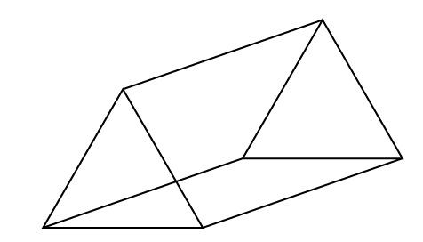
Prisms and Pyramids
Prism
Lateral faces are rectangular.
Two bases.
Pyramid
Lateral faces are triangular.
One base.

Slide 5
Classification
Prisms and pyramids are classified according to the shape of their base.

Slide 6
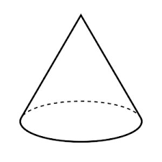
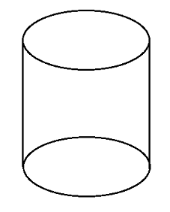
Cylinders and cones
Cylinders and cones are not polyhedral because they have curved lateral faces.
Cone
One base.
Cylinder
Two bases.

Slide 7
12.2 – Surface Area of Prisms and Cylinders

Slide 8
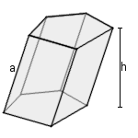
Oblique prisms and cylinders.
Solids are oblique when they are slanted. In this case, the height of the prisms and cylinder does not correspond to the edges.
Oblique prism: Oblique cylinder:

Slide 9
Area definitions
Lateral area includes the area of all the lateral faces.
Surface area includes the area of lateral faces and bases.
For prisms and cylinders:
$$SA=LA+2∙A_{base}$$
For pyramids and cones:
$$SA=LA+A_{base}$$

Slide 10
Prisms and cylinders as layering of shapes
Using this method, we can use the formula:
$$LA=P_{base}∙h$$
$$SA=P_{base}∙h+2A_{base}$$

Slide 12
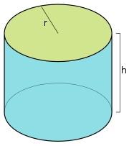
Prisms and cylinders as layering of shapes
$$LA=P_{base}∙h$$
$$SA=P_{base}∙h+2A_{base}$$
For cylinders, we can replace the perimeter and area by their formulas, which give us:
$$LA=2πr∙h$$
$$SA=2πrh+2πr^{2}$$

Slide 13
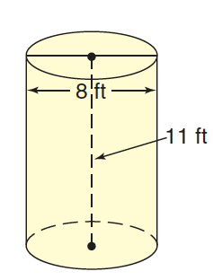
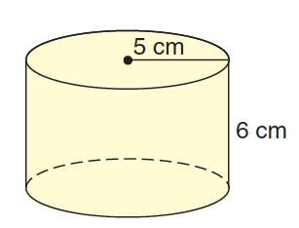

Slide 14
12.3 – Surface Area of Pyramids and Cones

Slide 15
Area using nets

Slide 16
Area using perimeter
$$LA={\frac{1}{2}P}_{base}∙l$$
$$SA={\frac{1}{2}P}_{base}l+A_{base}$$
For a cone, you can replace perimeter and area of circle by their formula.
$$LA=πrl$$
$$SA=πrl+πr^{2}$$

Slide 19
12.4 – Volume of Prisms and Cylinders

Slide 20
Definition: Volume
Volume is the amount of space contained in a solid. It is measured in cubic units.

Slide 21
Volume of Prisms and Cylinders
Formula:
$$V=A_{base}∙h$$
For cylinders, you can replace the area by the formula for the area of a circle.
$$V=πr^{2}∙h$$

Slide 22
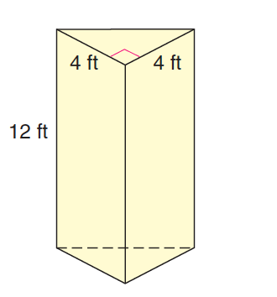

Slide 23
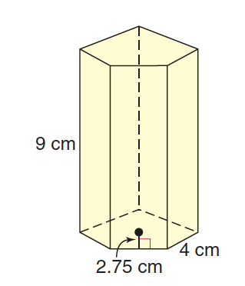

Slide 24
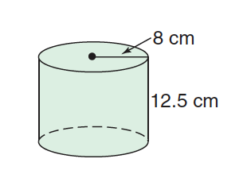

Slide 26
12.5 – Volume of Pyramids and Cones

Slide 27
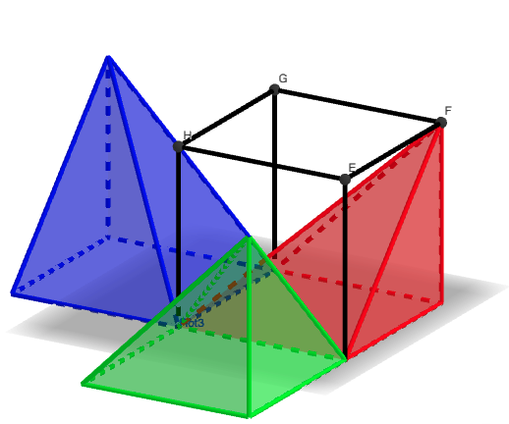
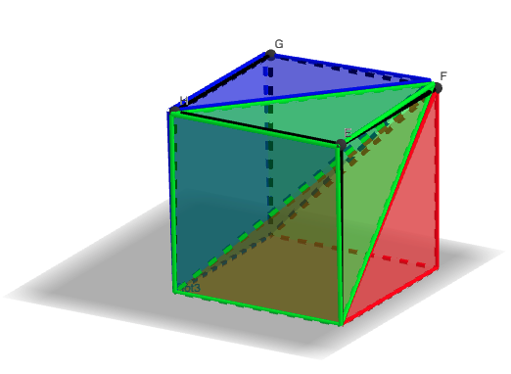
Volume of a pyramid demo
https://www.geogebra.org/m/jwf5y73q

Slide 28
Volume of pyramids and cones
$$V=\frac{1}{3}A_{base}∙h$$
For a cone, replace with formula for area of a circle:
$$V=\frac{1}{3}πr^{2}h$$

Slide 31
12.6 – Surface Area and Volume of Spheres

Slide 32
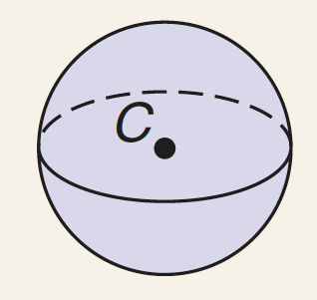
Area and Volume Formulas
Spheres have no base, so there is only one area (no distinction between lateral and surface areas.)
Surface Area: $S=4πr^{2}$
Volume: V$=\frac{4}{3}πr^{3}$

Slide 34
Area and volume of composite solids
To find the area or volume of composite solids, calculate the area or volume of the individual solids they are made up of and add them together.

Slide 35
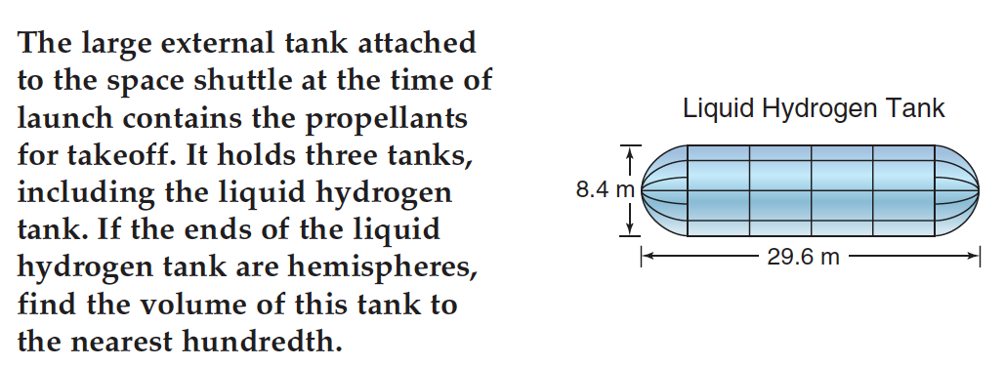

Slide 36
12.8 – Congruent and Similar Solids

Slide 37
Similar solids
Just like similar figures, similar solids have the same shape, but not the same size. All their measures are proportional.

Slide 39
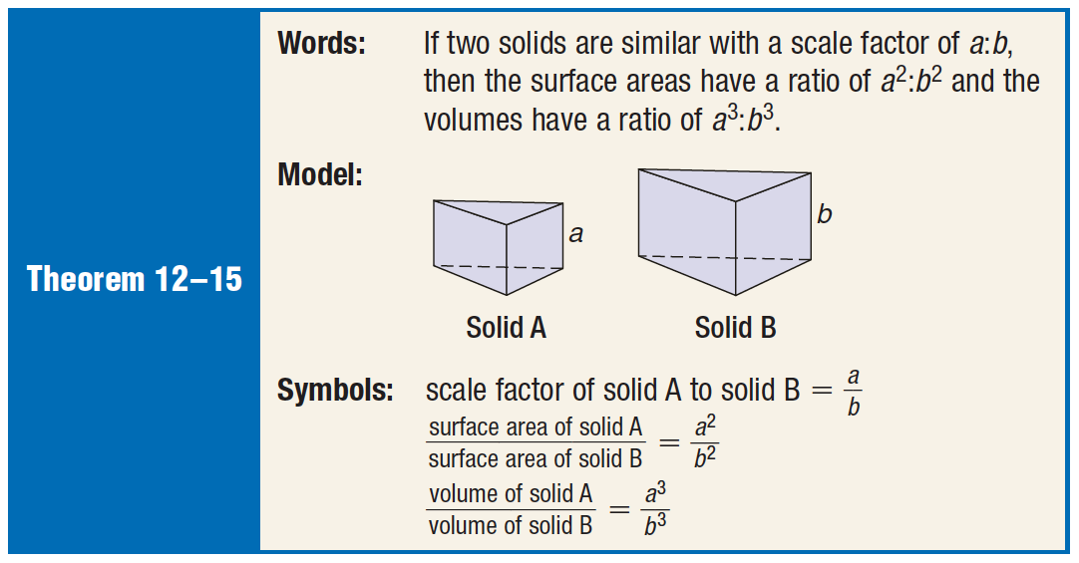
Scale factor relationships
In similar solids, the areas and volumes are also proportional, but their scale factors are squares for area and cubed for volume.

Slide 40
