Slide 1
Chapter 11: Areas of Polygons and Circles

Slide 2
11.1 – Areas of Parallelograms and Triangles

Slide 3

Parallelogram
https://www.geogebra.org/m/VCUCx4jh

Slide 4

Parallelogram

Slide 5
Parallelogram

Slide 6
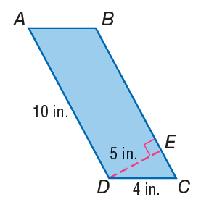

Parallelogram

Slide 7


Slide 8

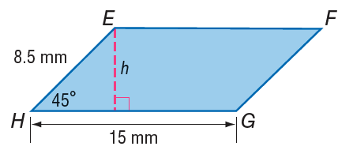

Slide 9


Slide 10

Triangles

Slide 11

Triangles

Slide 12


Slide 13


Slide 14
11.2 – Areas of Trapezoids, Rhombi and Kites

Slide 15
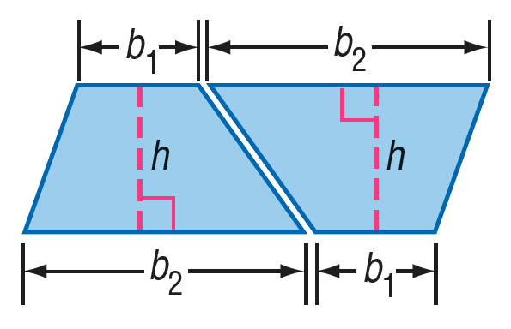
Trapezoid
https://www.geogebra.org/m/T8ZfVMFK

Slide 16

Trapezoid

Slide 17

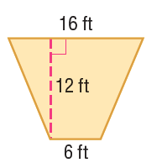
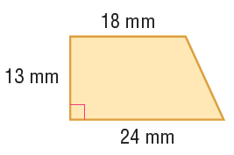

Slide 18
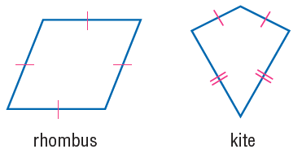

Rhombus and Kite

Slide 19

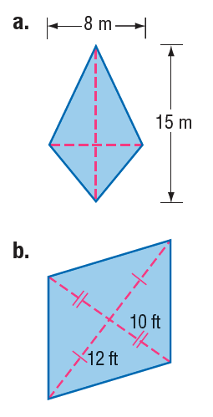

Slide 20

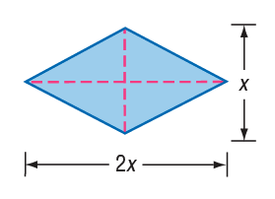
Solving for unknowns

Slide 21
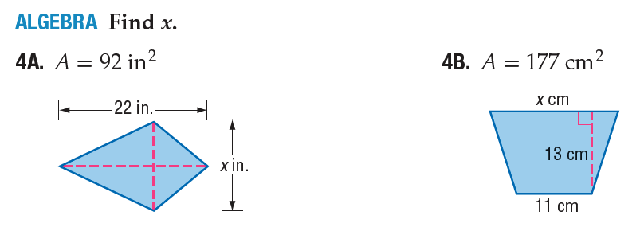

Slide 22
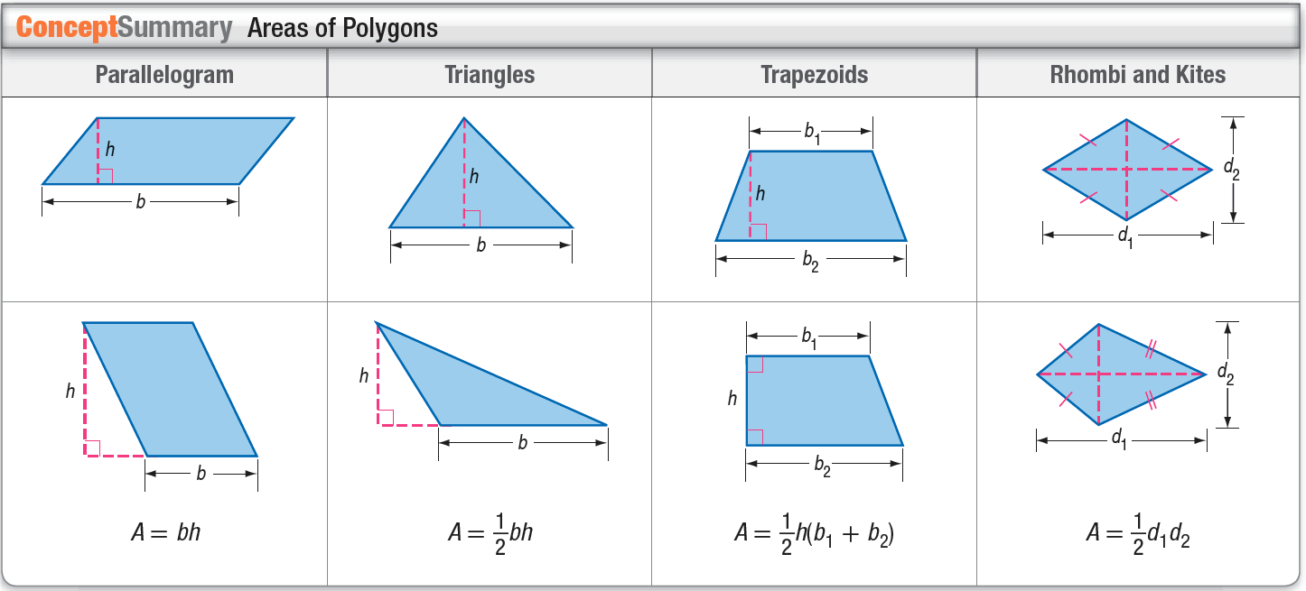

Slide 23
11.3 – Areas of Circles and Sectors

Slide 24


Slide 25
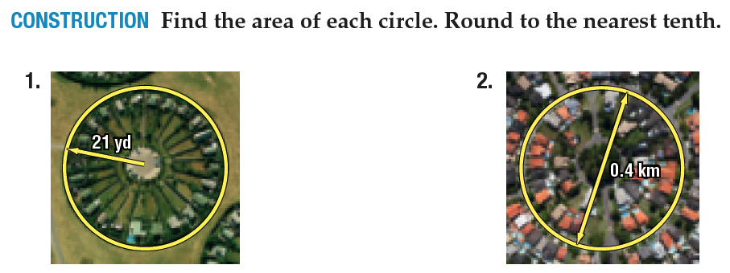

Slide 26
Finding missing measures

Slide 27

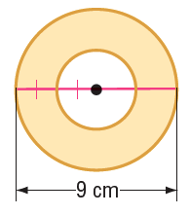

Slide 28
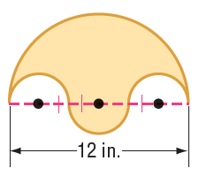

Slide 29
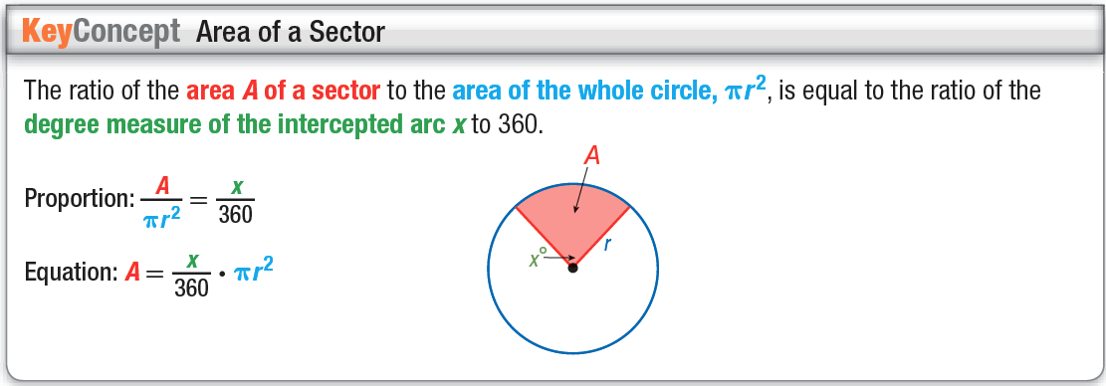
Area of sectors

Slide 31


Slide 32
11.4 – Areas of Regular Polygons and Composite Figures

Slide 33

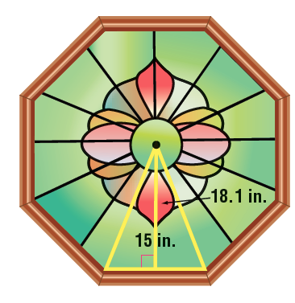


Slide 34
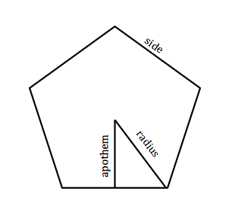
Parts of a polygon

Slide 35

Area of a regular polygon

Slide 36

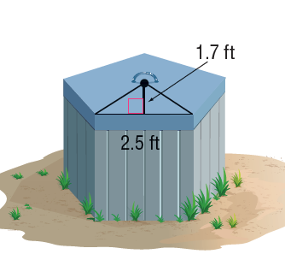

Slide 37

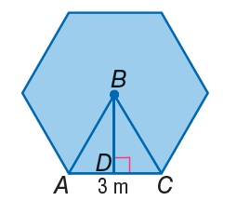

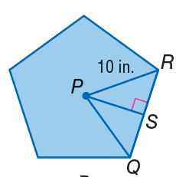

Slide 38
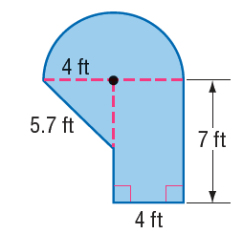

Area of composite figures

Slide 39


Slide 40

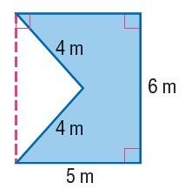

Slide 41


Slide 42
11.5 – Areas of similar figures

Slide 43
Similar figures
- Two figures are similar when their corresponding sides are proportional → the ratio is called the scale factor.
- The perimeter of these figures is also proportional.

Slide 44

Area of Similar figures
The areas of similar figures are proportional to the square of the scale factor.

Slide 45


Slide 46
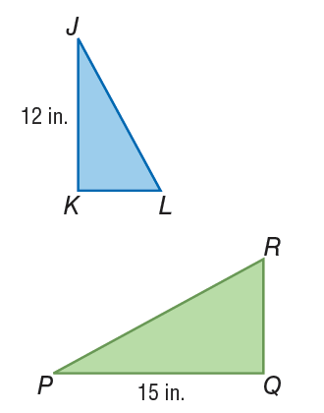

Finding the area from length measures.

Slide 47


Slide 48

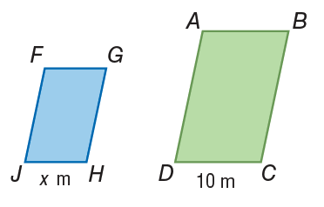
Finding lengths from areas.

Slide 49


