Slide 1
10.6 – Secants, Tangents, and Angle Measures

Slide 2
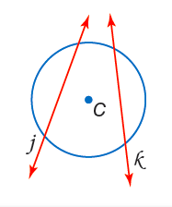
Definition: Secant
A secant is a line that intersects a circle in two points.

Slide 3
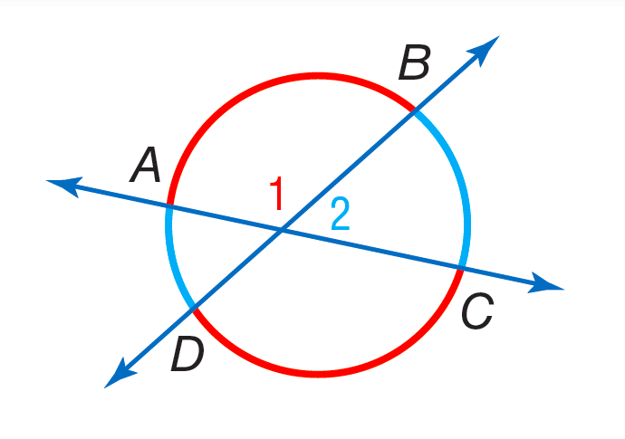
Secants intersecting inside a circle
$m∠1=\frac{m\hat{AB}+m\hat{DC}}{2}$

Slide 4
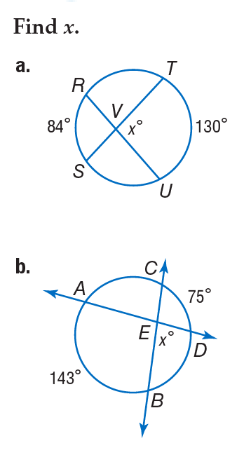

Slide 5
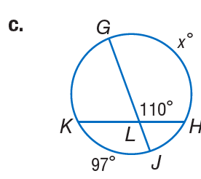
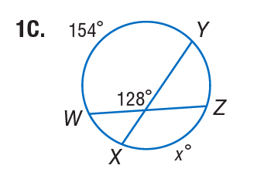

Slide 6
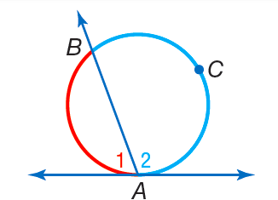
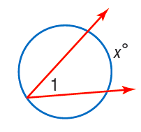
Secants/tangents intersecting on a circle
$m∠1=\frac{m\hat{AB}}{2}$

Slide 7
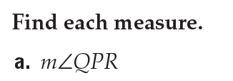
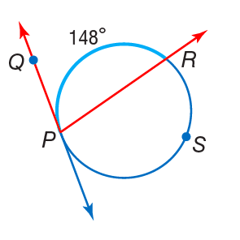
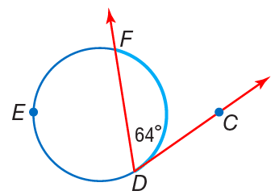

Slide 8
Secants intersecting outside a circle

Slide 9
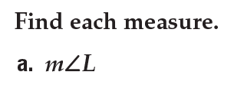
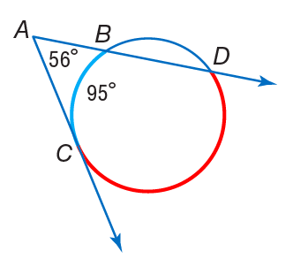
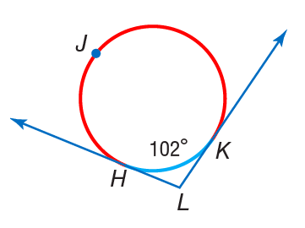

Slide 10
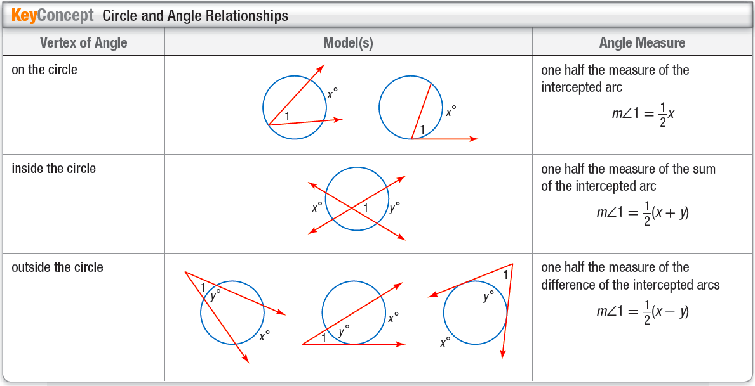

Slide 11
10.7 – Special Segments in a Circle

Slide 12
Secants intersecting inside a circle
Please refer to the table completed in class.

Slide 13
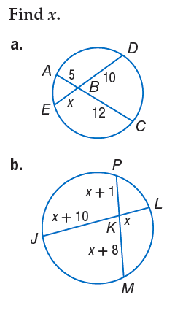

Slide 15
Secants intersecting outside a circle

Slide 16
Review of the Quadratic Formula
Given $ax^{2}+bx+c=0$,
$$x=\frac{−b±\sqrt{b^{2}−4ac}}{2a}$$

Slide 17
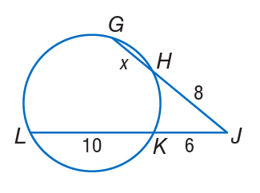

Slide 18
Tangent and secant intersecting outside a circle

Slide 19
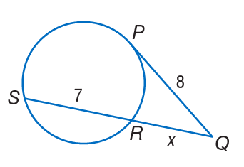

Slide 21
10.8 – Equations of Circles

Slide 22
Equation of a circle
$${(x−h)}^{2}+{(y−k)}^{2}=r^{2}$$

Slide 23
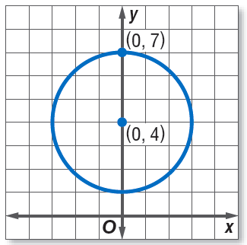

Slide 25
Equation of a circle from the center and a point.

Slide 27
