Slide 1
Chapter 10: Circles

Slide 2
10.1 – Circles and Circumference

Slide 3
Definition: Circle

Slide 4
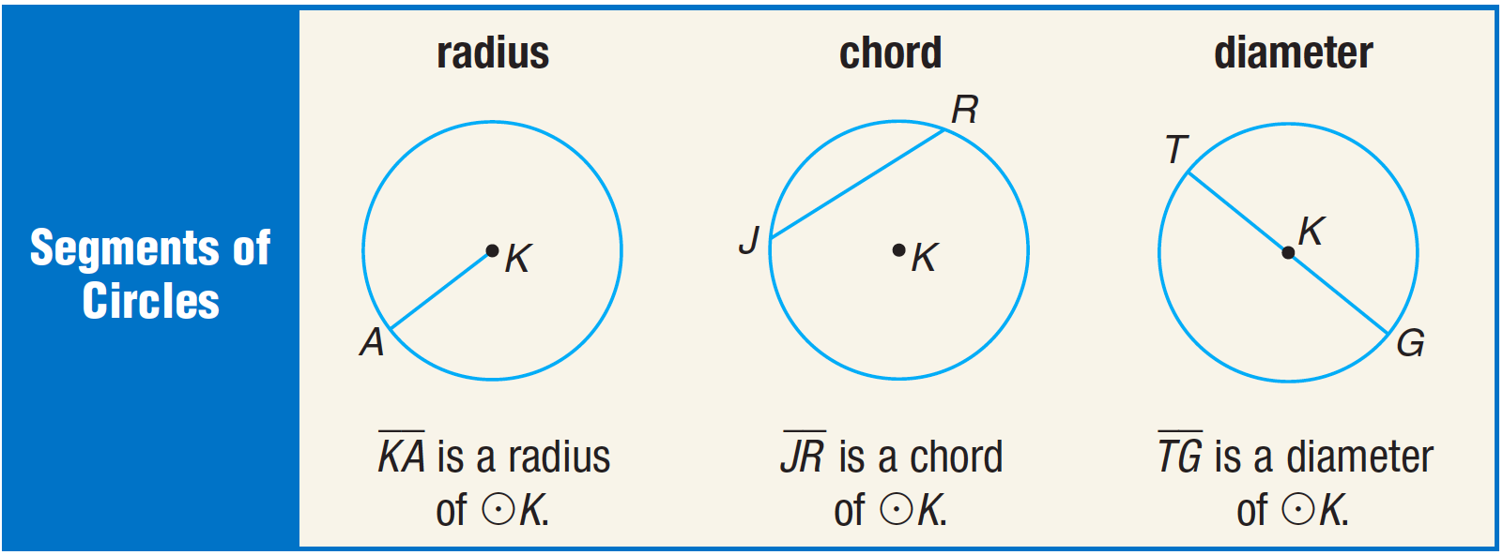
Special segments in circles

Slide 5
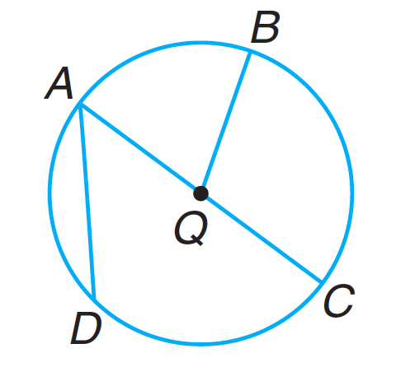

Slide 6
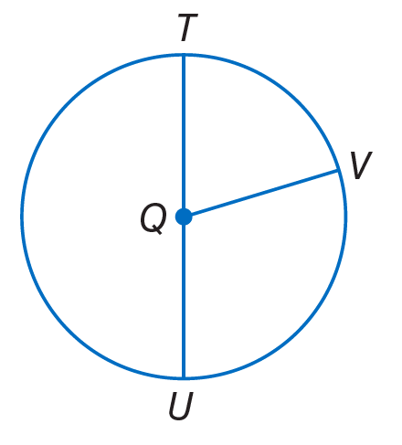
Radius and Diameter Relationships

Slide 7
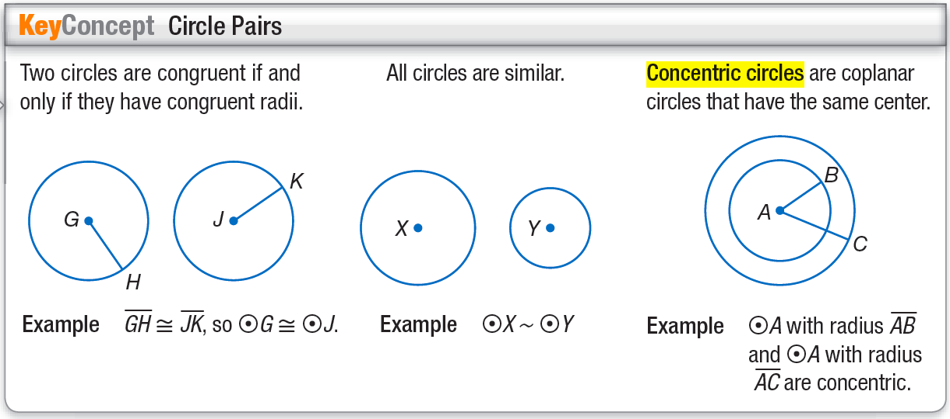
Circle Pairs

Slide 8
Circle Intersections

Slide 9
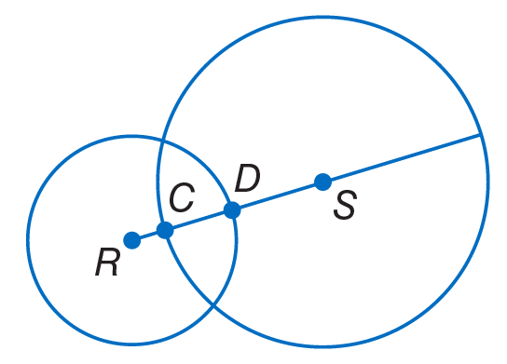

Slide 10
Circumference

Slide 11
Finding radius/diameter from circumference

Slide 12
10.2 – Measuring Angels and Arcs

Slide 13
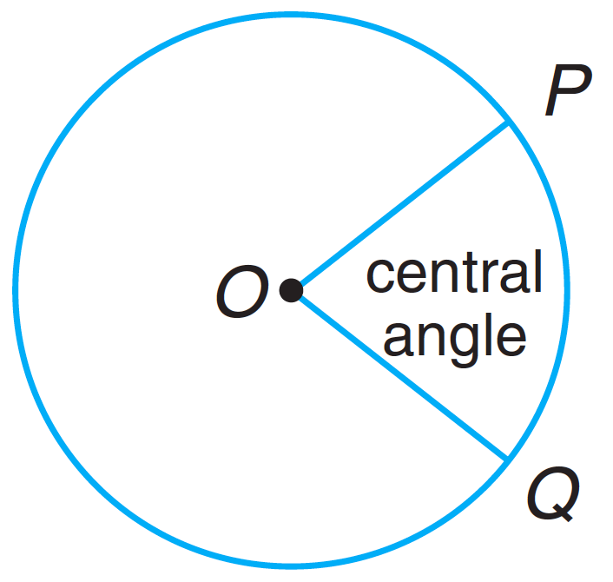
Central Angles
A central angle is formed when two sides of an angle meet at the center of the circle. The parts of the circle that are intercepted are called arcs.
Minor arcs are less than 180 degrees.
Major arcs are more than 180 degrees.
Semicircles are 180 degrees.

Slide 14
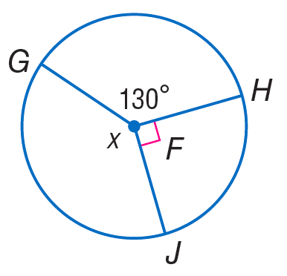
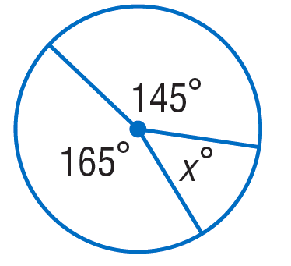
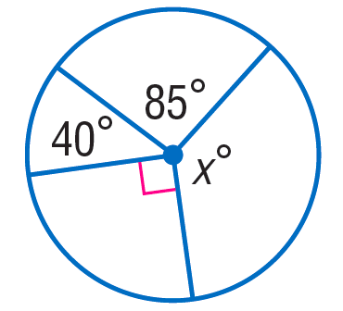
Central Angles

Slide 15
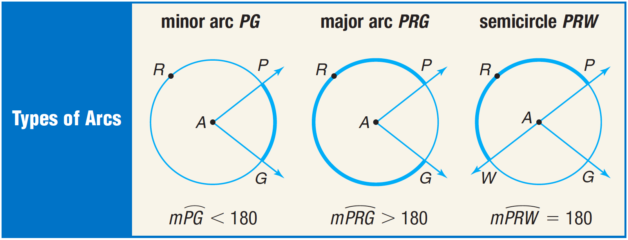
Central Angles

Slide 17
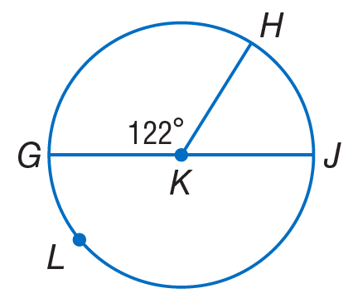
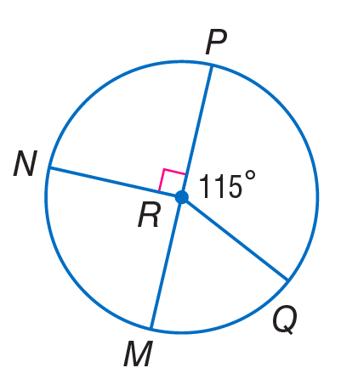

Slide 18
Central Angles

Slide 19
Adjacent arcs
Adjacent arcs are right next to each other.

Slide 20
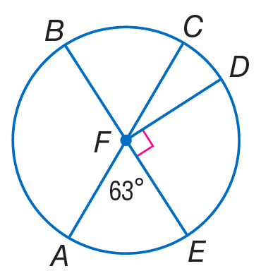

Slide 21
Arc Length

Slide 22
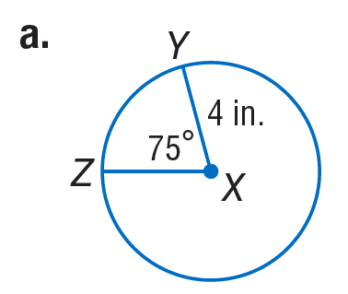
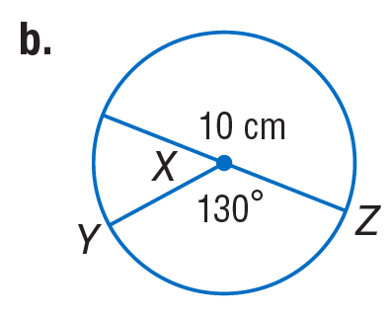
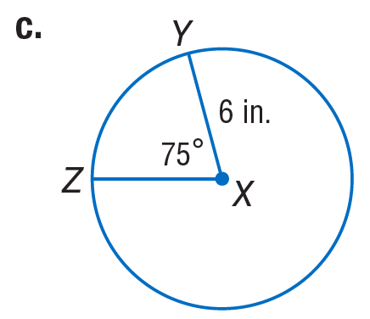

Slide 24
10.3 – Arcs and Chords

Slide 25
Congruent Arcs and Chords

Slide 26
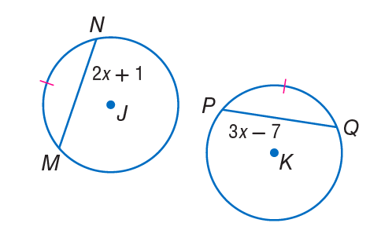
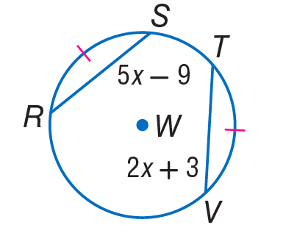

Slide 27
Bisecting Arcs and Chords

Slide 28
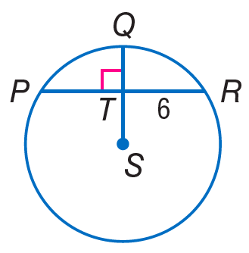
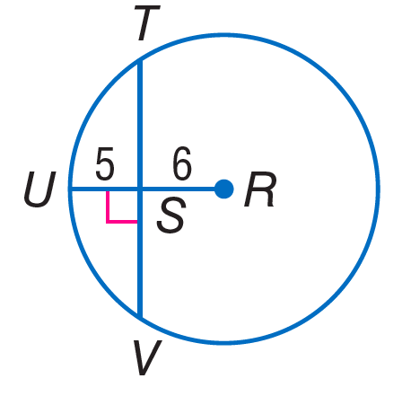

Slide 29
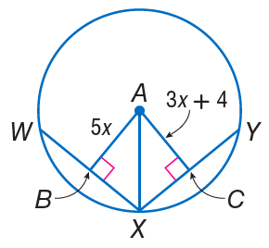
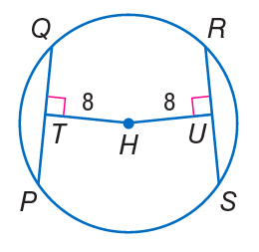
Chords equidistant from the center

Slide 30
10.4 – Inscribed Angles

Slide 31
10.4 – Inscribed Angles

Slide 32
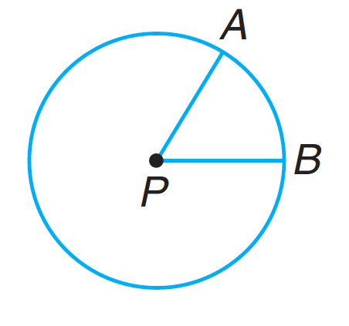
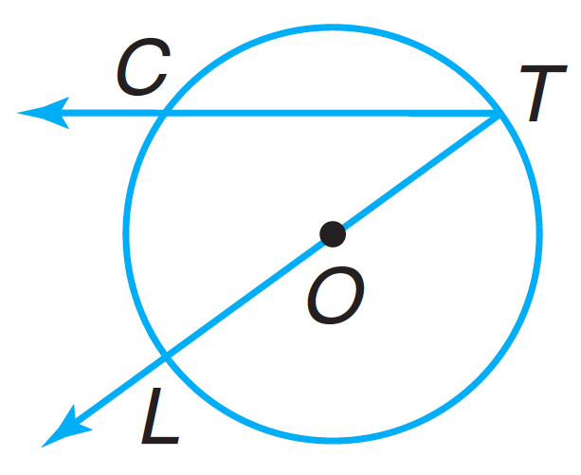
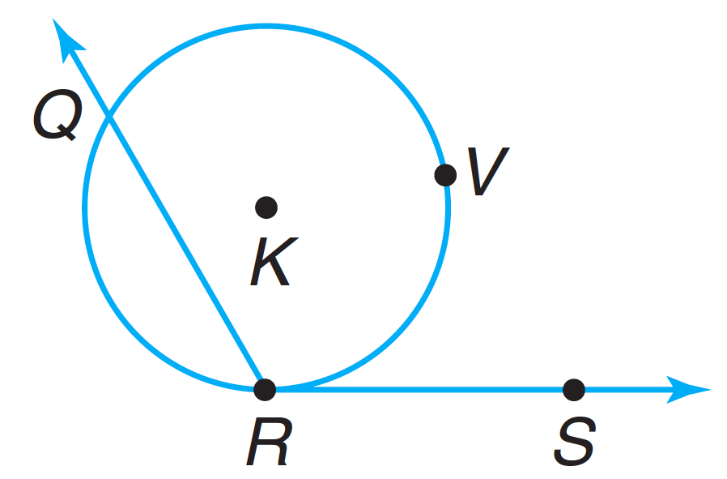
Inscribed Angle

Slide 33
Inscribed angle demonstration
https://www.geogebra.org/m/c86sMaNc

Slide 34
Measures of inscribed angles

Slide 35
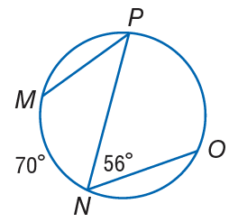
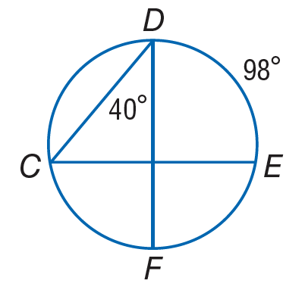

Slide 36
Inscribed angle demonstration
https://www.geogebra.org/m/YpkYEpdA

Slide 37
Measures of inscribed angles

Slide 38
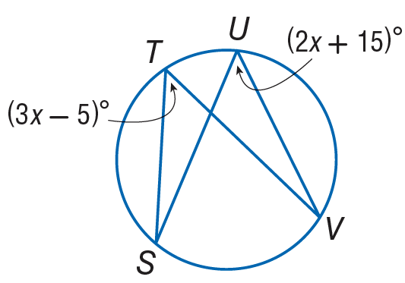

Slide 39
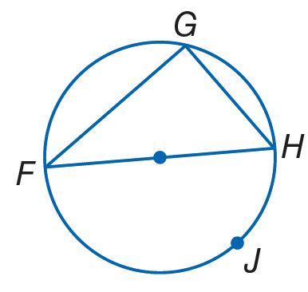
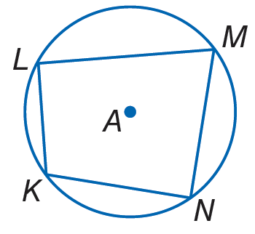
Angles of inscribed polygons

Slide 40
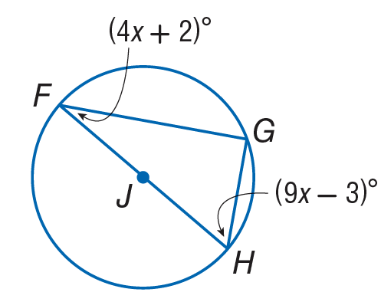

Slide 41
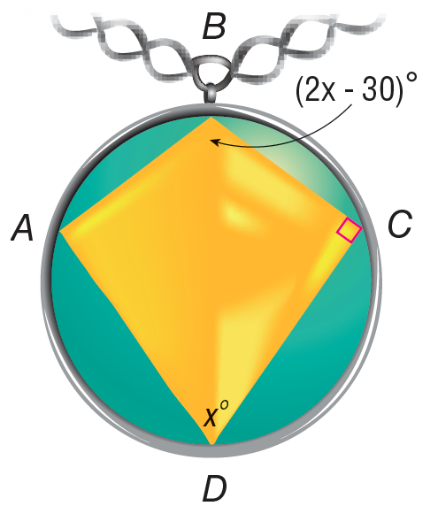
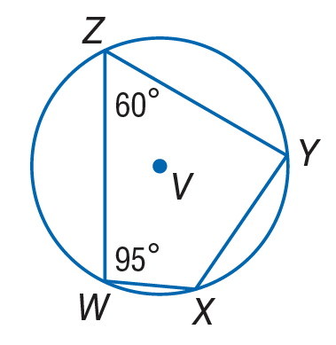

Slide 42
10.5 – Tangents

Slide 43
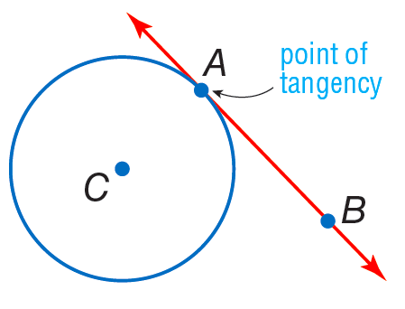
Definition: Tangent
A line is tangent to a circle if it touches the circle in only one place.

Slide 44
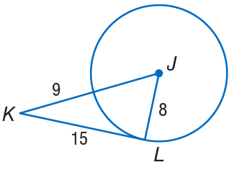
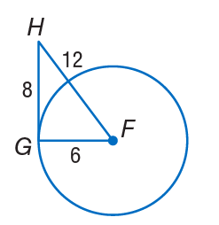

Slide 45
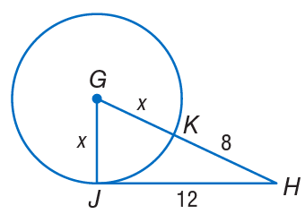

Slide 47
Two intersecting tangents to a circle

Slide 48
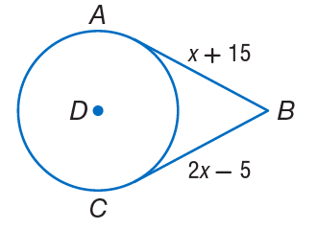

Slide 50
Circumscribed Polygons

Slide 51
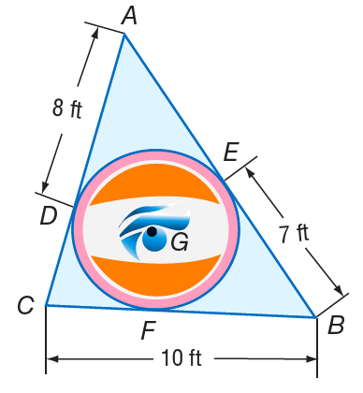

Slide 52
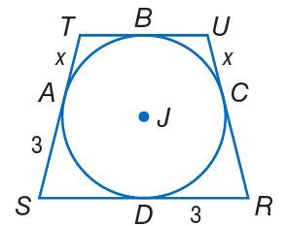

Slide 53
10.6 – Secants, Tangents, and Angle Measures

Slide 54
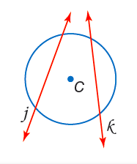
Definition: Secant
A secant is a line that intersects a circle in two points.

Slide 55
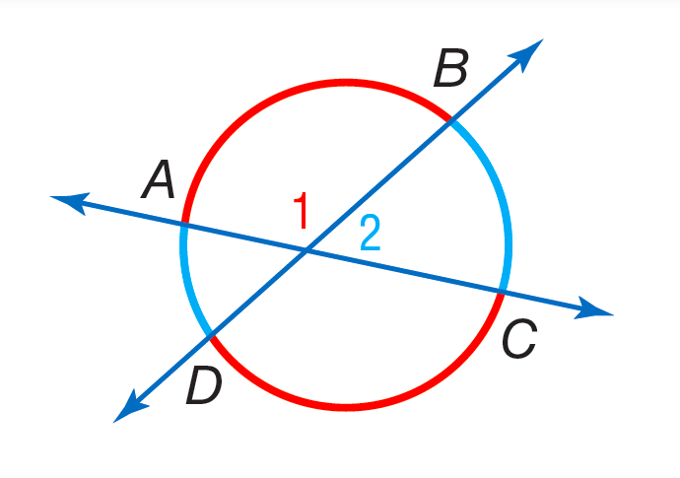
Secants intersecting inside a circle
$m∠1=\frac{m\hat{AB}+m\hat{DC}}{2}$

Slide 56
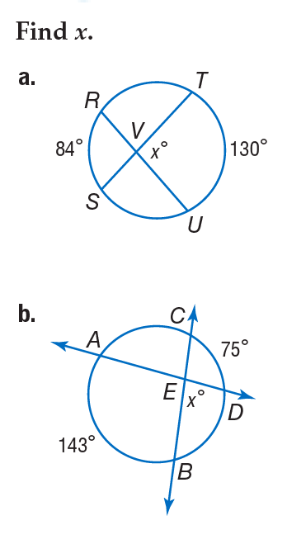

Slide 57
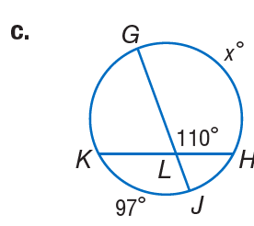
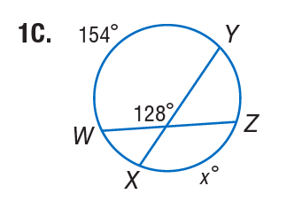

Slide 58
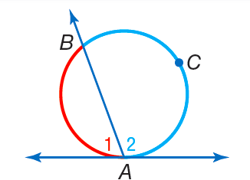
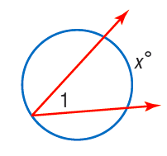
Secants/tangents intersecting on a circle
$m∠1=\frac{m\hat{AB}}{2}$

Slide 59
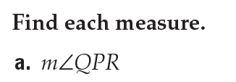
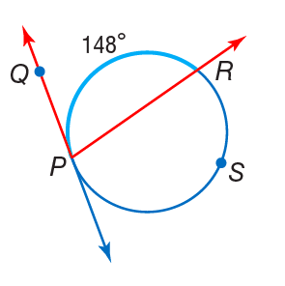
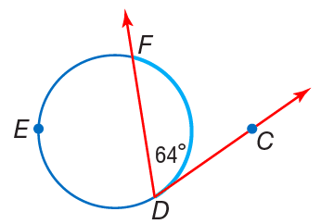

Slide 61
Secants intersecting outside a circle
$m∠1=\frac{m\hat{AB}−m\hat{DC}}{2}$

Slide 64
Arc and Angle Measures Recap
Please refer to the table completed in class.

Slide 66
10.7 – Special Segments in a Circle

Slide 67
Secants intersecting inside a circle
Please refer to the table completed in class.

Slide 70
Secants intersecting outside a circle

Slide 72
Tangent and secant intersecting outside a circle

Slide 73
Review of the Quadratic Formula
Given $ax^{2}+bx+c=0$,
$$x=\frac{−b±\sqrt{b^{2}−4ac}}{2a}$$

Slide 76
10.8 – Equations of Circles

Slide 77
Equation of a circle
$${(x−h)}^{2}+{(y−k)}^{2}=r^{2}$$

Slide 80
Equation of a circle from the center and a point.

