Slide 1
Chapter 10: Circles

Slide 2
10.1 – Circles and Circumference

Slide 3
Definition: Circle

Slide 4
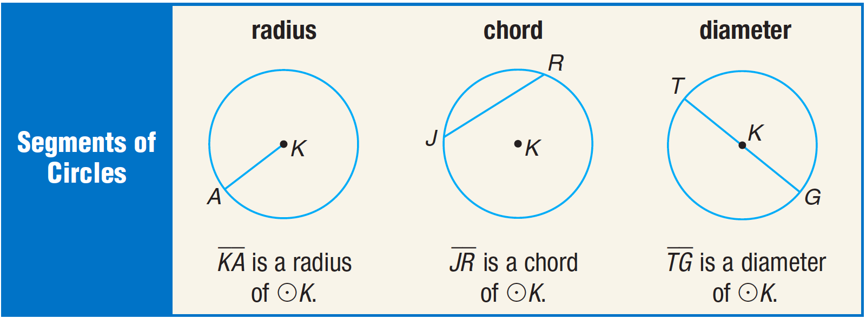
Special segments in circles

Slide 5
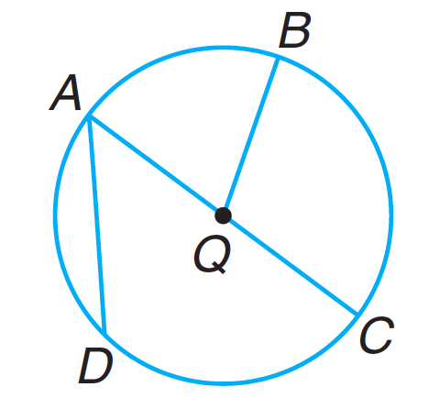

Slide 6
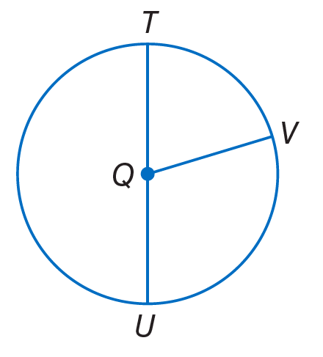
Radius and Diameter Relationships

Slide 7
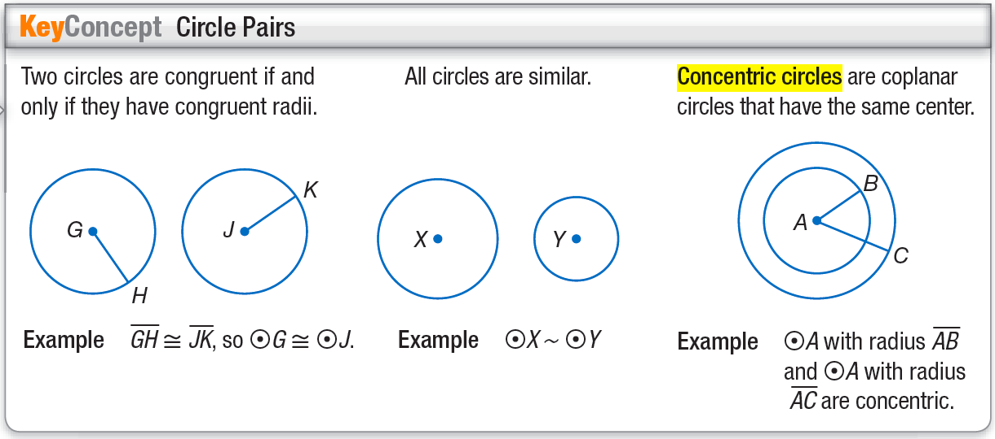
Circle Pairs

Slide 8
Circle Intersections

Slide 9
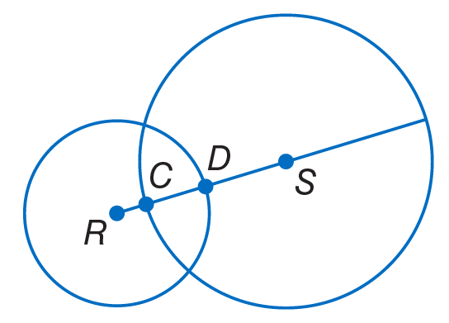

Slide 10
Circumference

Slide 11
Finding radius/diameter from circumference

Slide 12
10.2 – Measuring Angles and Arcs

Slide 13
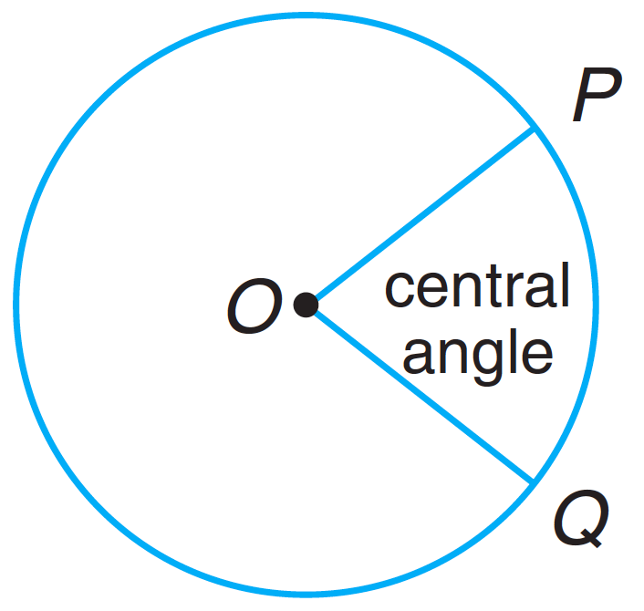
Central Angles
A central angle is formed when two sides of an angle meet at the center of the circle. The parts of the circle that are intercepted are called arcs.
Minor arcs are less than 180 degrees.
Major arcs are more than 180 degrees.
Semicircles are 180 degrees.

Slide 14
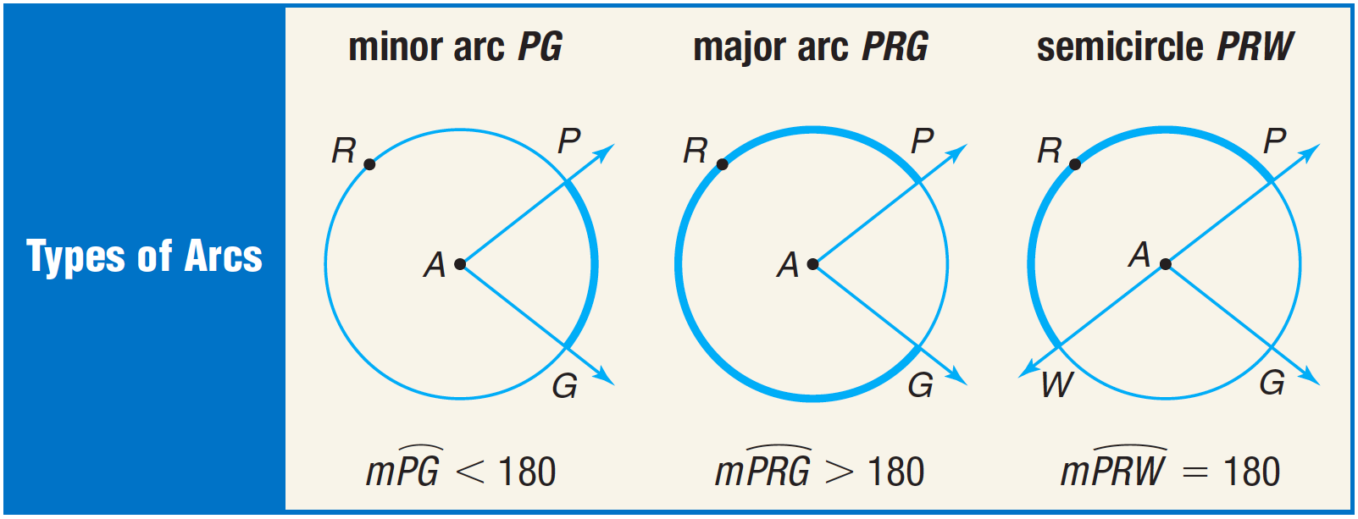
Central Angles

Slide 15
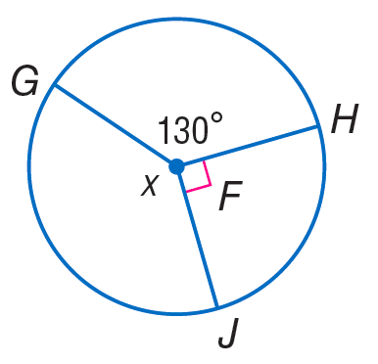
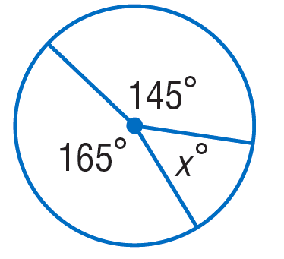
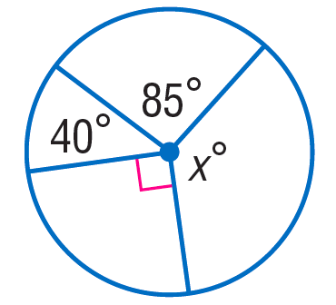
Central Angles

Slide 17
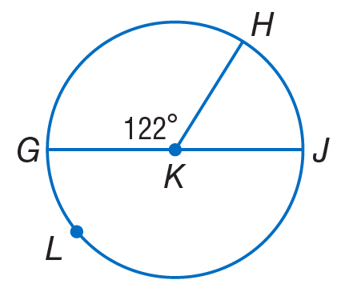
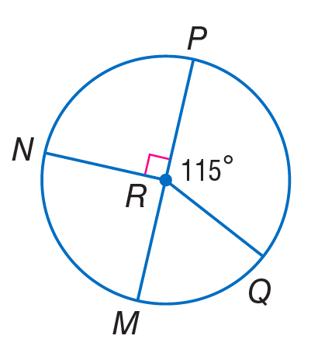

Slide 18
Central Angles

Slide 19
Adjacent arcs
Adjacent arcs are right next to each other.

Slide 20
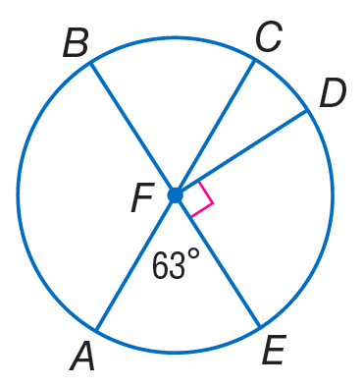

Slide 21
Arc Length

Slide 22
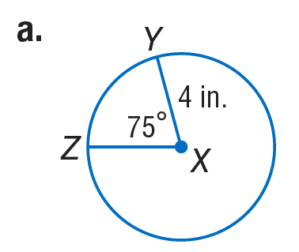
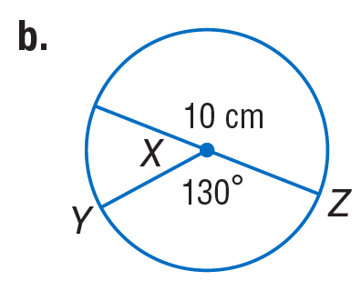
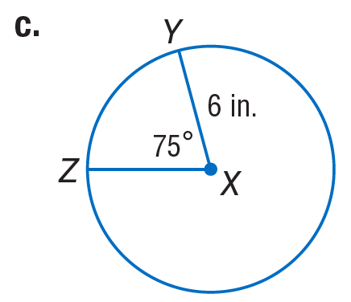

Slide 24
10.3 – Arcs and Chords

Slide 25
Congruent Arcs and Chords

Slide 26
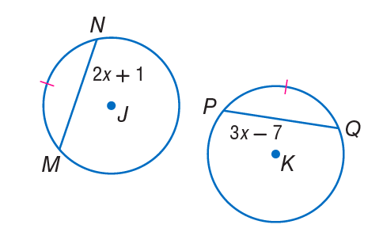
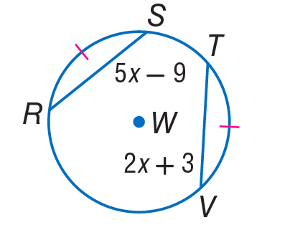

Slide 27
Bisecting Arcs and Chords

Slide 28
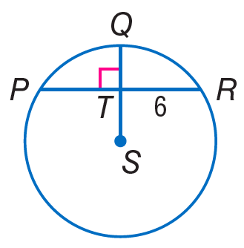
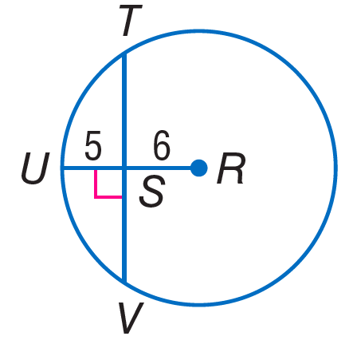

Slide 29
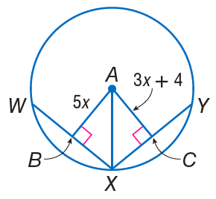
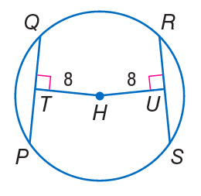
Chords equidistant from the center

Slide 30
10.4 – Inscribed Angles

Slide 31
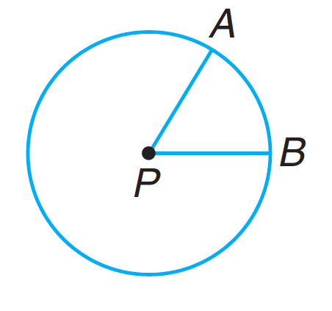
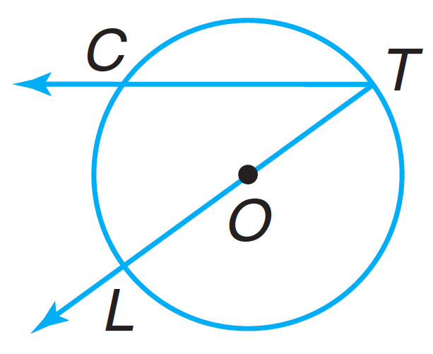
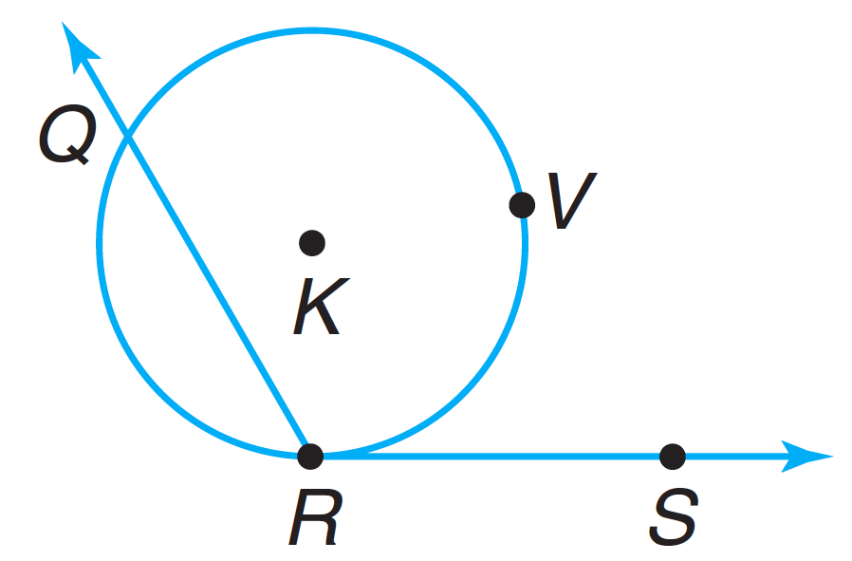
Inscribed Angle

Slide 32
Inscribed angle demonstration
https://www.geogebra.org/m/c86sMaNc

Slide 33
Measures of inscribed angles

Slide 34
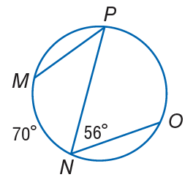
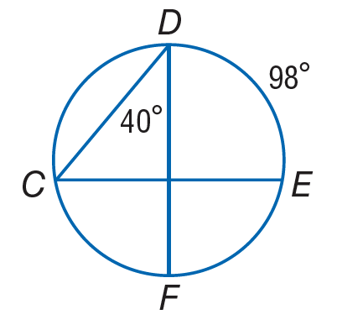

Slide 35
Inscribed angle demonstration
https://www.geogebra.org/m/YpkYEpdA

Slide 36
Measures of inscribed angles

Slide 37
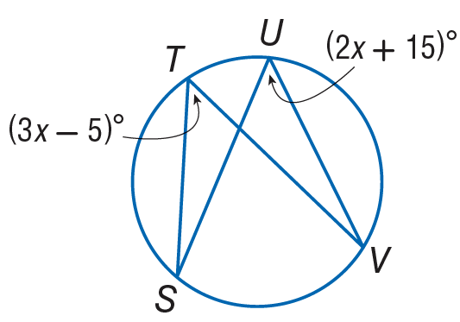

Slide 38
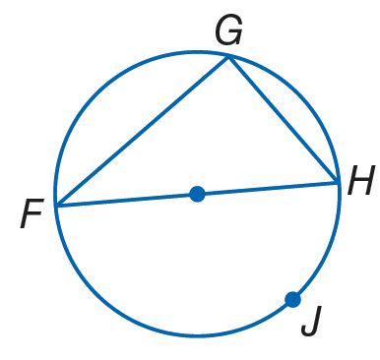
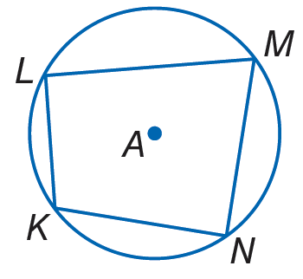
Angles of inscribed polygons

Slide 39
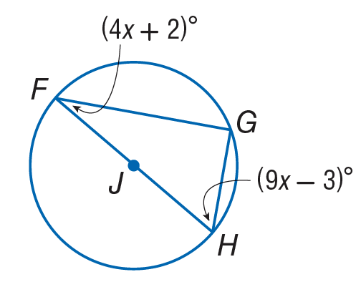

Slide 40
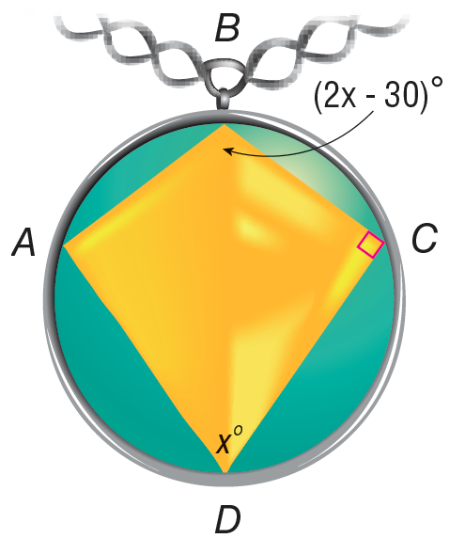
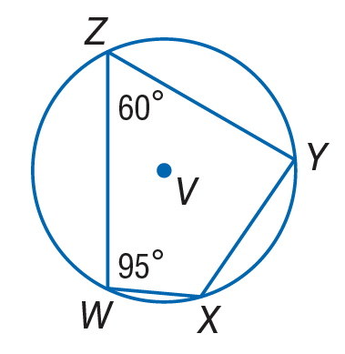

Slide 41
10.5 – Tangents

Slide 42
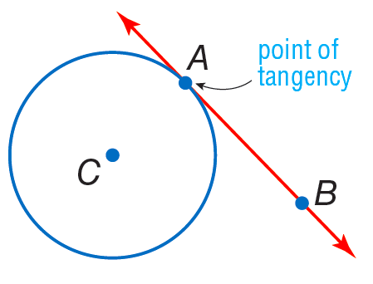
Definition: Tangent
A line is tangent to a circle if it touches the circle in only one place.

Slide 43
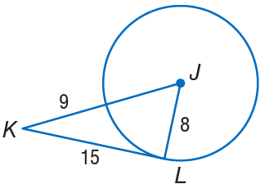
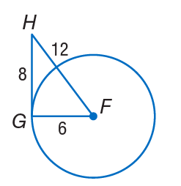

Slide 44
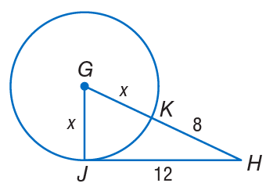

Slide 46
Two intersecting tangents to a circle

Slide 47
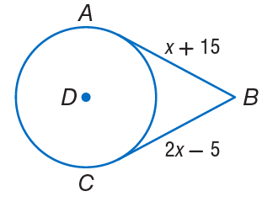

Slide 49
Circumscribed Polygons

Slide 50
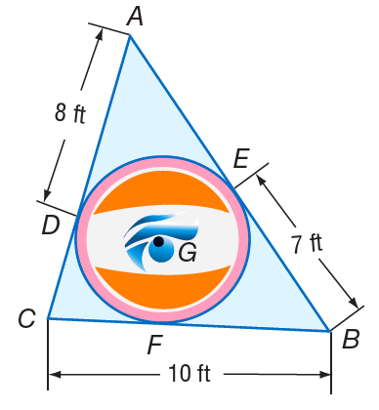

Slide 51
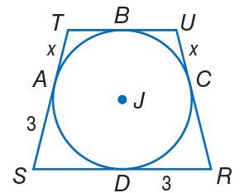

Slide 52
10.6 – Secants, Tangents, and Angle Measures

Slide 53
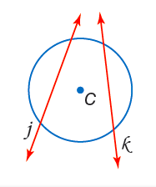
Definition: Secant
A secant is a line that intersects a circle in two points.

Slide 54
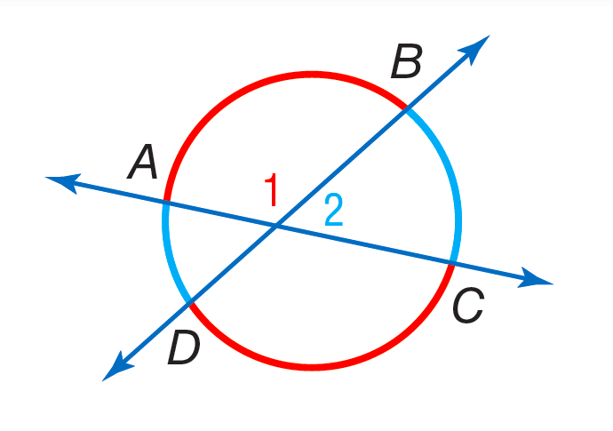
Secants intersecting inside a circle
$m∠1=\frac{m\hat{AB}+m\hat{DC}}{2}$

Slide 55
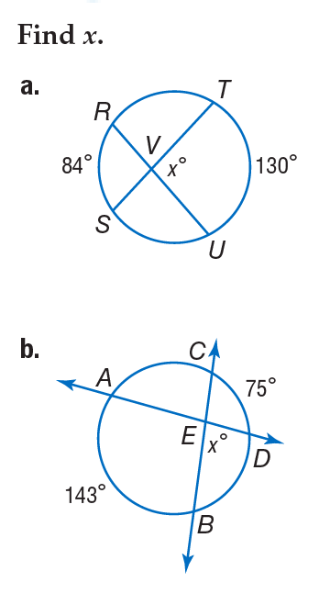

Slide 56
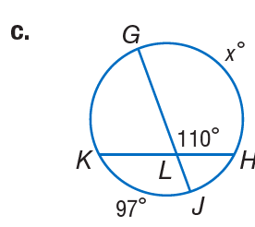
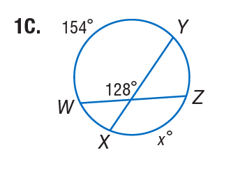

Slide 57
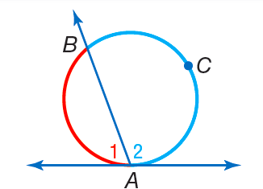
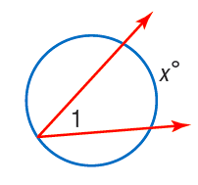
Secants/tangents intersecting on a circle
$m∠1=\frac{m\hat{AB}}{2}$

Slide 58
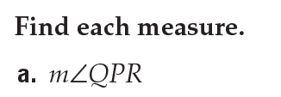
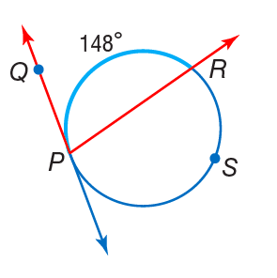
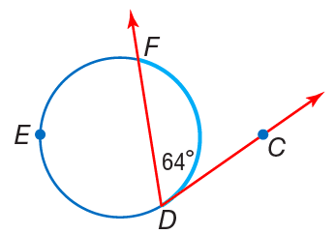

Slide 60
Secants intersecting outside a circle
$m∠1=\frac{m\hat{AB}−m\hat{DC}}{2}$

Slide 63
Arc and Angle Measures Recap
Please refer to the table completed in class.

Slide 65
10.7 – Special Segments in a Circle

Slide 66
Secants intersecting inside a circle
Please refer to the table completed in class.

Slide 69
Secants intersecting outside a circle

Slide 71
Tangent and secant intersecting outside a circle

Slide 72
Review of the Quadratic Formula
Given $ax^{2}+bx+c=0$,
$$x=\frac{−b±\sqrt{b^{2}−4ac}}{2a}$$

Slide 75
10.8 – Equations of Circles

Slide 76
Equation of a circle
$${(x−h)}^{2}+{(y−k)}^{2}=r^{2}$$

Slide 79
Equation of a circle from the center and a point.

