Slide 1
Chapter 9 – Rational Equations and Functions

Slide 2
9.1 – Inverse and joint variation

Slide 3
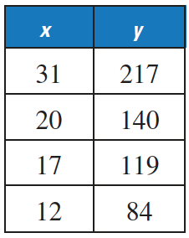
Direct variation
Direct variation occurs if $y=kx$, where $k$ is a constant.
To check for direct variation, divide the output by the input. Direct variation will always yield the same ratio.

Slide 4
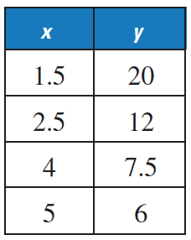
Inverse variation
Inverse variation occurs if $y=\frac{k}{x}$, where $k$ is a non-zero constant.
To check for direct variation, multiply the output by the input. Inverse variation will always yield the same product.

Slide 5
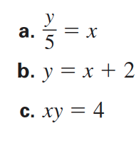
Classifying direct and inverse variation

Slide 6
Classifying direct and inverse variation

Slide 7
Writing inverse variation equations

Slide 8
Writing inverse variation equations

Slide 9
Joint Variation
Joint variation occurs when a quantity varies directly as the product of two or more other quantities. $z=kxy$

Slide 10
Joint Variation

Slide 11
Joint Variation

Slide 12
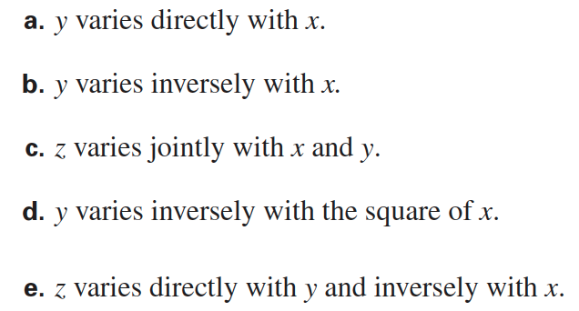
Comparing variations

Slide 13
9.2 – Graphing Simple Rational Equations

Slide 14
Basic rational function
A rational function is of the form $f\left(x\right)=\frac{p(x)}{q(x)}$, where $p(x)$ and $q(x)$ are polynomials and $q(x)≠0$.
It has two parts called branches.

Slide 15
Basic rational function
A rational function where the top and bottom polynomial are both linear (first degree).
The graph is called a hyperbola.
It has a horizontal and a vertical asymptote.
It has two parts called branches.
Domain and range are all real number except for the values of the asymptotes.

Slide 16
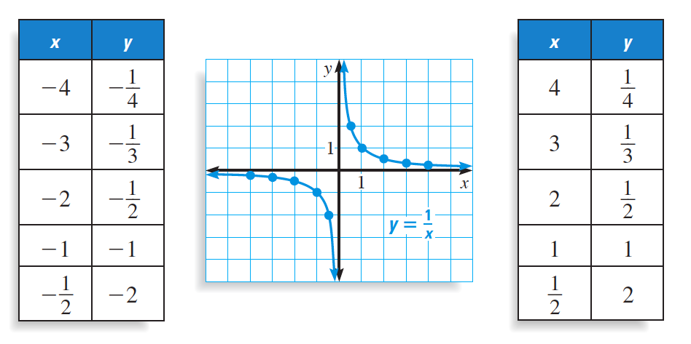
Basic rational function
$$f\left(x\right)=\frac{1}{x}$$
Domain and range are all real number except for x =0 and y = 0.

Slide 17
rational function with transformations
Is of the form $f\left(x\right)=\frac{a}{x−h}+k or f\left(x\right)=\frac{ax+b}{cx+d}$.
In the form $f\left(x\right)=\frac{a}{x−h}+k$, the asymptotes are $x=h$ and $y=k.$
In the form $f\left(x\right)=\frac{ax+b}{cx+d}$, the asymptotes are $x=\frac{−d}{c}$ and $y=\frac{a}{c}.$

Slide 18
Graphing rational functions with transformations
1) Find and graph the asymptotes.
2) Graph two points on each side of the vertical asymptote.

Slide 19
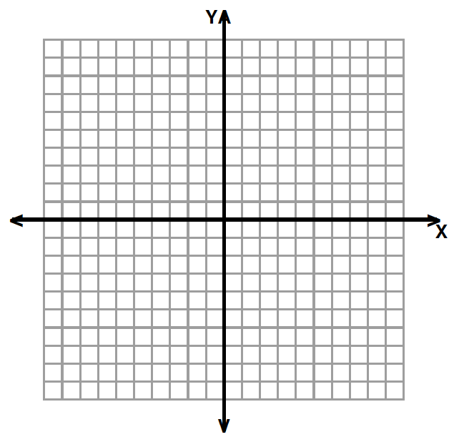

Slide 21
9.3 – Graphing General Rational Functions

Slide 22
Characteristics of general rational function
For a rational function of the form $f\left(x\right)=\frac{p(x)}{q(x)}$, where $p(x)$ and $q(x)$ are polynomials and $q(x)≠0$:
The x-intercepts of the graph are the real zeros of $p\left(x\right).$
The graph has vertical asymptotes at all the real zeros of $q\left(x\right).$

Slide 23
Horizontal asymptotes of general rational function
For a rational function of the form
$$f\left(x\right)=\frac{p(x)}{q(x)}=\frac{a_{m}x^{m}+a_{m−1}x^{m−1}+…+a_{1}x+a_{0}}{b_{n}x^{n}+b_{n−1}x^{n−1}+…+b_{1}x+b_{0}}$$

Slide 24
Horizontal asymptotes of general rational function
Polynomial characteristic | Asymptote / End behavior
Bottom polynomial has higher degree. | $$y=0$$
Polynomials have same degree. | $y=\frac{a_{m}}{b_{n}}$
Top polynomial has higher degree. | $y=\frac{a_{m}}{b_{n}}x^{m−n}$
$$f\left(x\right)=\frac{a_{m}x^{m}+a_{m−1}x^{m−1}+…+a_{1}x+a_{0}}{b_{n}x^{n}+b_{n−1}x^{n−1}+…+b_{1}x+b_{0}}$$
$$f\left(x\right)=\frac{a_{m}x^{m}+a_{m−1}x^{m−1}+…+a_{1}x+a_{0}}{b_{n}x^{n}+b_{n−1}x^{n−1}+…+b_{1}x+b_{0}}$$

Slide 25
Graphing rational functions with transformations
1) Find and graph the asymptotes.
2) Find and graph the zeros.
3) Find and graph some points around the asymptotes.

Slide 27
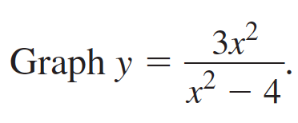

Slide 29
9.4 – Multiplying and dividing rational Expressions

Slide 30
Simplifying a rational expression

Slide 31
Multiplying rational expressions

Slide 32
Multiplying rational expressions by a polynomial

Slide 33
Dividing rational expressions

Slide 34
Multiplying and DIviding

Slide 35
9.5 – Addition, Subtraction and complex fractions

Slide 36
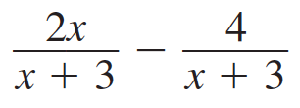
Adding / Subtracting rational expressions with same denominators

Slide 37
Adding rational expressions with different denominators

Slide 38
Subtracting rational expressions with different denominators

Slide 39
Simplifying complex fractions

Slide 40
complex fractions “cheat sheet”
$\frac{\frac{a}{b}}{c}=\frac{a}{bc}$
$\frac{a}{\frac{b}{c}}=\frac{ac}{b}$
$\frac{\frac{a}{b}}{\frac{c}{d}}=\frac{ad}{bc}$

Slide 41
9.6 – Solving rational equations

Slide 42
Steps to solving
1) Find the least common denominator of all the rational parts.
2) Multiply both sides by the LDC.
3) Solve the remaining equation.
4) Check for extraneous solutions.

Slide 43
Equation with one solution

Slide 44
Equation with an extraneous solution

Slide 45
Equation with Two solutions

Slide 46
Solving by cross-multiplying

