Slide 1
Chapter 14: Graphing Trigonometric Functions

Slide 2
What the basic Sine function represents
If you are following a point going around on a circle, sine tracks the y-value of the point.
Demo: https://www.desmos.com/calculator/b8tjkyjesu

Slide 3
What the basic Cosine function represents
If you are following a point going around on a circle, cosine tracks the x-value of the circle.
Demo: https://www.desmos.com/calculator/eouprsrtuc

Slide 4
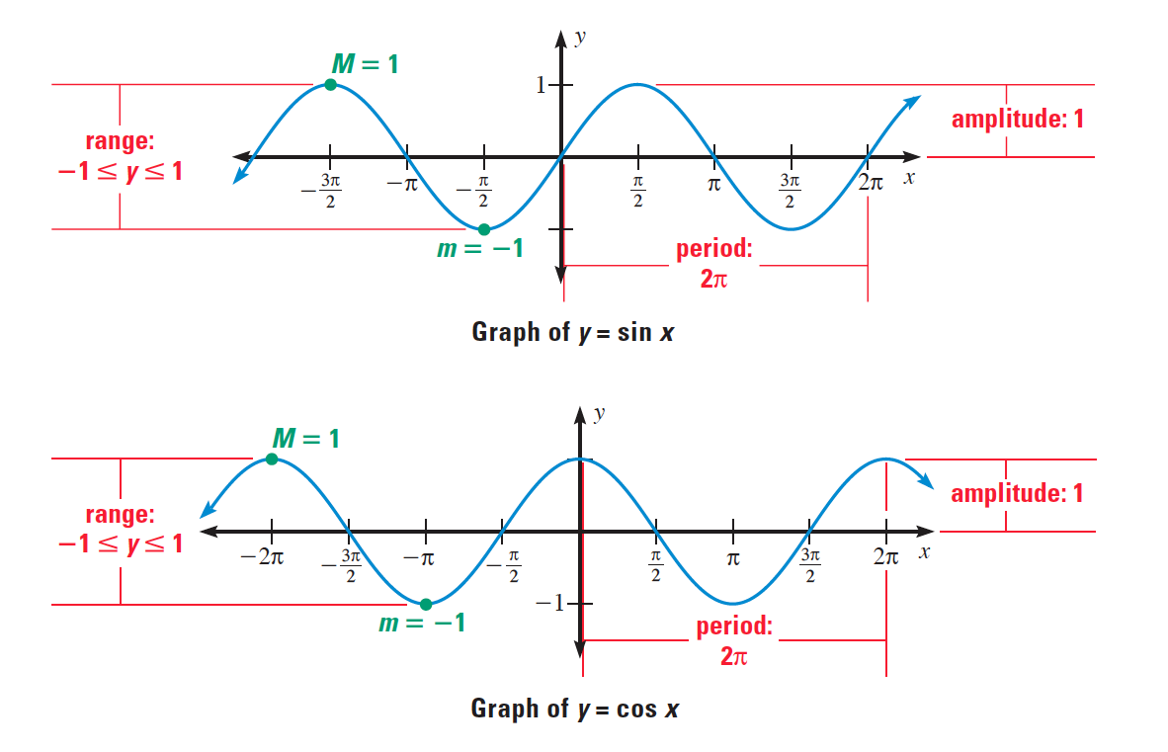

Slide 5
Characteristics of basic sine and cosine functions
Domain: $ℝ$
Range: $−1≤y≤1$ for basic function.
Functions are periodic, sine and cosine have a period of $2π$.
Has a max of 1 and min of -1.
The amplitude is half the distance between the max and min.
Sine starts at the midline, cosine starts at a max or min.

Slide 6
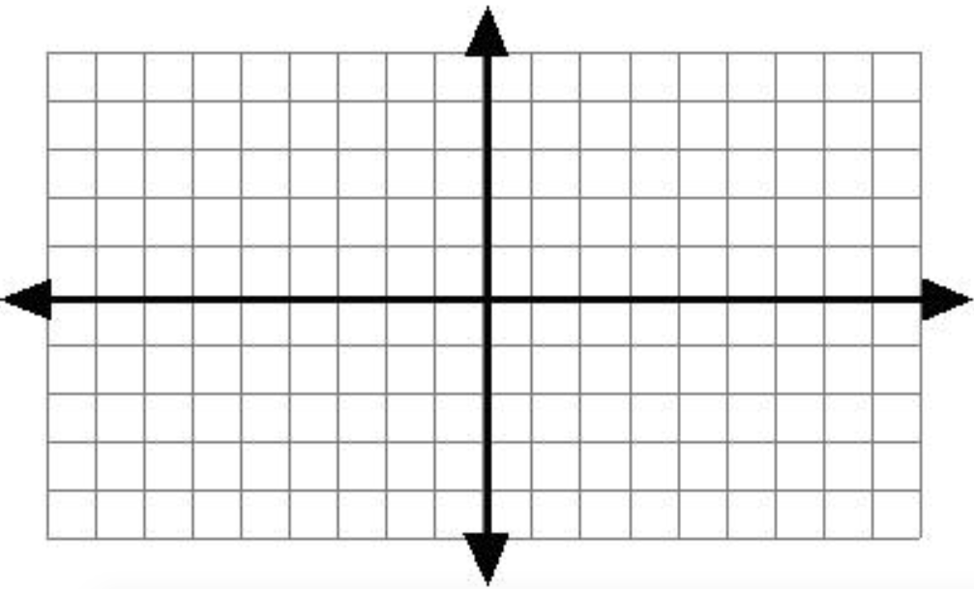
Graphing basic Sine and Cosine Functions.
$$y=sin⁡(x)$$
$$y=cos⁡(x)$$
Period:
Midline:
Max line:
Min line:
Cycle start:
Cycle End:
Period:
Midline:
Max line:
Min line:
Cycle start:
Cycle End:

Slide 7

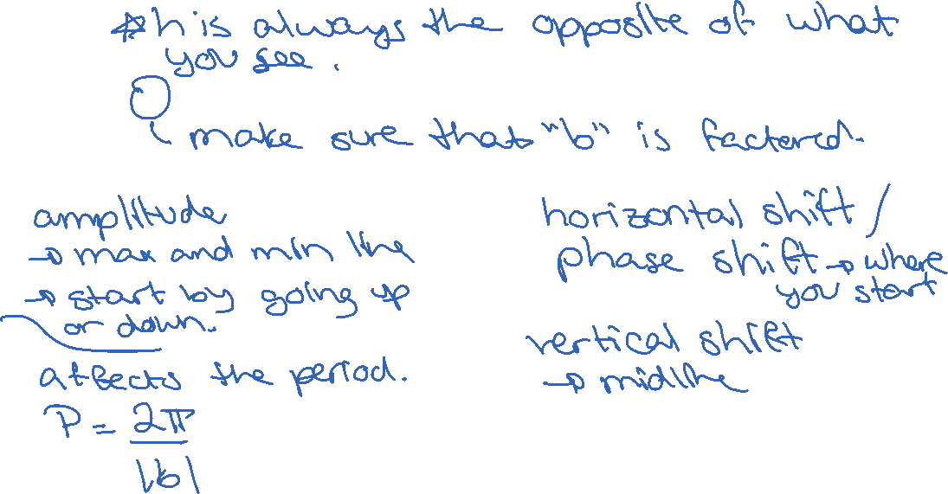
Transformed Sine and Cosine Functions
$y=a\sin{b(x−h)}+k$ $y=a\cos{b(x−h)}+k$
a: h:
b: k:

Slide 8
Steps to Graph Transformed Sine and Cosine Functions
Determine the period: $P=\frac{2π}{\left|b\right|}$. Use it to label the x-axis.
Determine the midline: $y=k$ and draw it.
Determine the max and min lines: $y=k+a$ and $y=k−a$ and draw them.
Determine starting point: $\left(0+h, k\right)$ for sine and $\left(0+h, k±a\right)$ for cos (do this visually).
Draw the point one period later.
Figure out if you are going up or down first. Draw the mid-period and quarter /3-quarter period points.
Draw the curve.

Slide 9
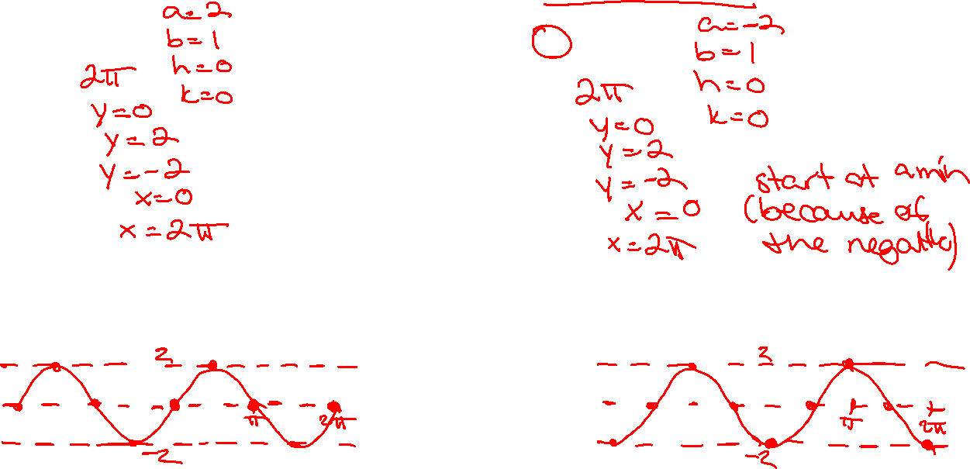
Graphing Sine and Cosine functions with amplitude change
$$y=2sin⁡(x)$$
$$y=−2cos⁡(x)$$
Period:
Midline:
Max line:
Min line:
Cycle start:
Cycle End:
Period:
Midline:
Max line:
Min line:
Cycle start:
Cycle End:

Slide 10
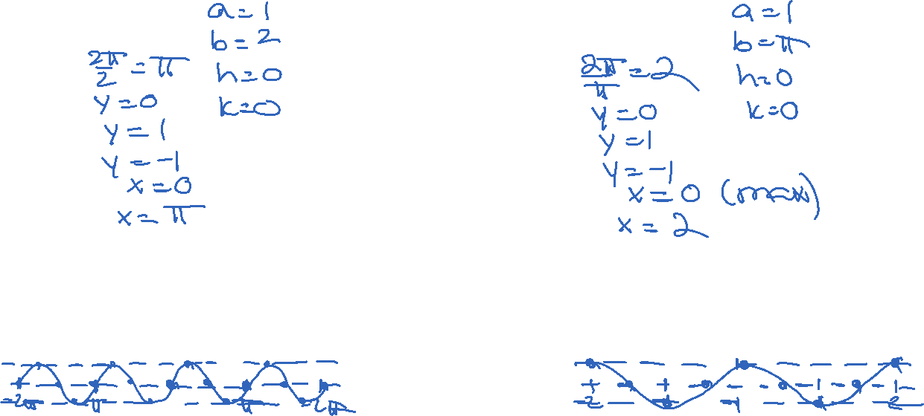
Graphing Sine and Cosine functions with period change
$$y=sin⁡(2x)$$
$$y=cos⁡(πx)$$
Period:
Midline:
Max line:
Min line:
Cycle start:
Cycle End:
Period:
Midline:
Max line:
Min line:
Cycle start:
Cycle End:

Slide 11
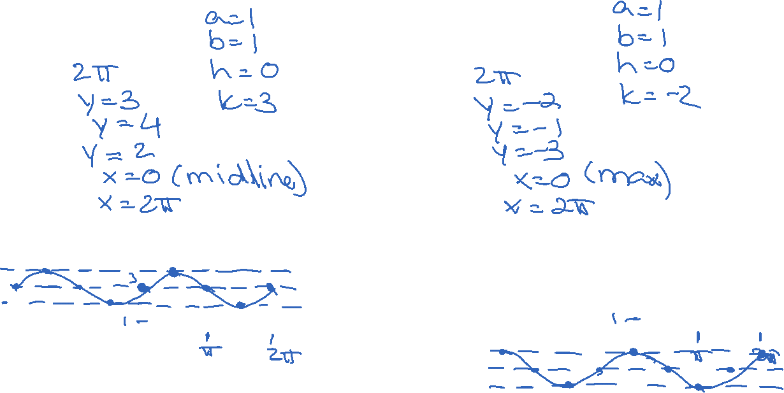
Graphing Sine and Cosine functions with vertical shift
$$y=\sin\left(x\right)+3$$
$$y=\cos\left(x\right)−2$$
Period:
Midline:
Max line:
Min line:
Cycle start:
Cycle End:
Period:
Midline:
Max line:
Min line:
Cycle start:
Cycle End:

Slide 12
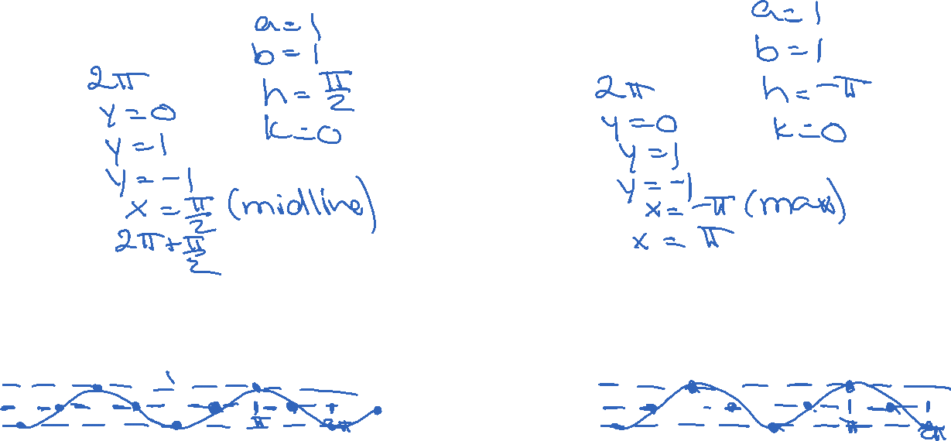
Graphing Sine and Cosine functions with phase shift
$$y=sin⁡(x−\frac{π}{2})$$
$$y=cos⁡(x+π)$$
Period:
Midline:
Max line:
Min line:
Cycle start:
Cycle End:
Period:
Midline:
Max line:
Min line:
Cycle start:
Cycle End:

Slide 13
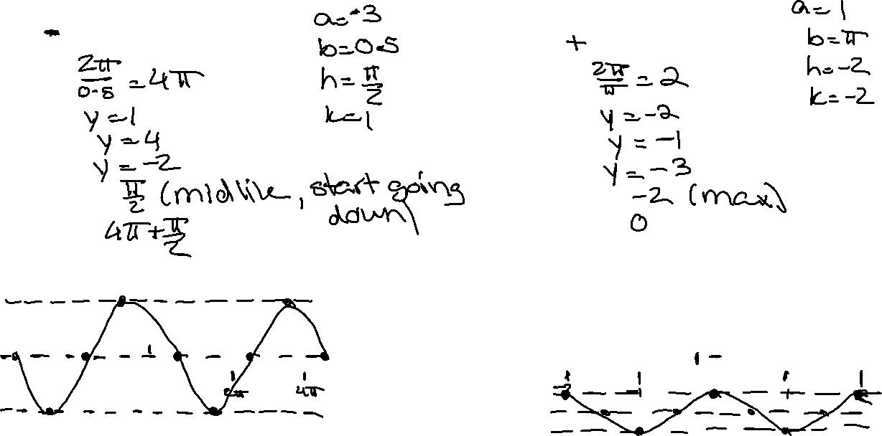
Graphing Sine and Cosine functions – all parameters
$$y=3\sin{0.5\left(x−\frac{π}{2}\right)}+1$$
$$y=−\cos{π\left(x+2\right)}−2$$
Period:
Midline:
Max line:
Min line:
Cycle start:
Cycle End:
Period:
Midline:
Max line:
Min line:
Cycle start:
Cycle End:

Slide 14
What the basic Tangent function represents
If you are following a point going around on a circle, tangent tracks the ratio of the y-value over the x-value of the point.
Demo: https://www.desmos.com/calculator/n9aeestsd8

Slide 15
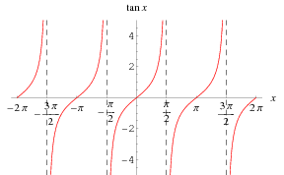
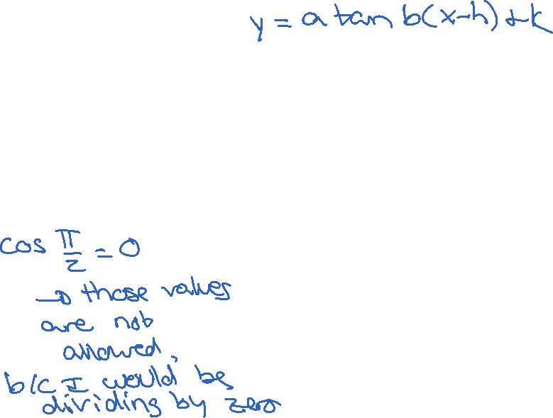
Characteristics of sine and cosine functions
Period is $\frac{2π}{\left|b\right|}$
Vertical asymptotes at odd multiples of $\frac{π}{2\left|b\right|}.$

