Slide 1
Chapter 13: Trigonometric Ratios and Functions

Slide 2
13.1 – Right Triangle Trigonometry

Slide 3
Recap of trigonometric ratios

Slide 4
Evaluating Trigonometric Ratios

Slide 5
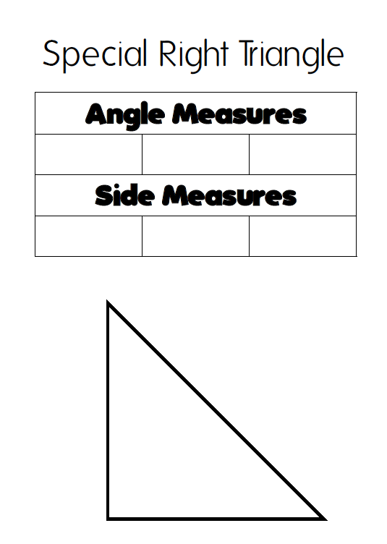

Slide 6
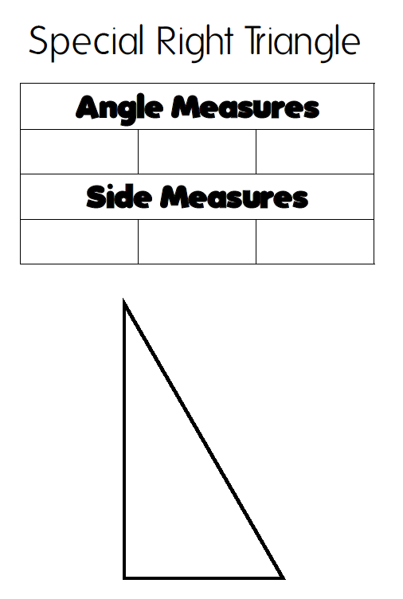

Slide 7
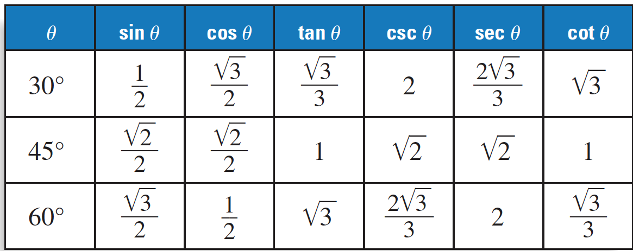
Ratios of Common Angles

Slide 8
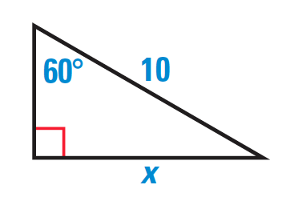

Slide 9
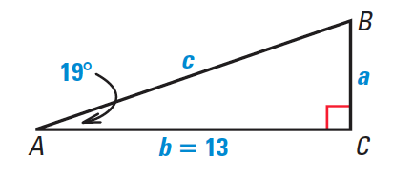
Solving Triangles
Solving triangles means finding the angles and sides.

Slide 10
Using Trigonometry in Real Life

Slide 11
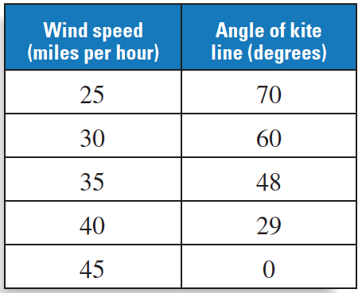

Slide 13
13.2 – General Angles and Radian Measure

Slide 14
Definitions
Initial side: Fixed side of the angle.
Terminal side: Side that results in the rotation.
Standard position: The initial side is aligned with the x-axis.
Coterminal angles: angles with different measures that have coinciding terminal sides.

Slide 15
Drawing angles in standard position

Slide 16
Finding coterminal angles
Coterminal angles can be found by adding or subtracting multiples of 360º.

Slide 17
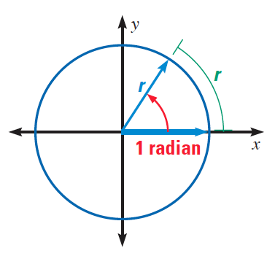
Radians
In a circle with radius r, one radian is the measure of an angle in standard position which intercepts and arc of length r.
There are $2π$ radians in a circle, because the circumference of a circle is $2πr$.

Slide 18
Degrees vs. Radians

Slide 19
Converting between degree and radian
1) Write a proportion:
$$\frac{degree measure}{180}=\frac{radian measure}{π}$$
2) Solve the proportion.

Slide 20
Converting between degree and radian

Slide 21
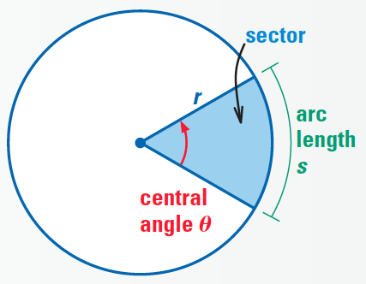
Arc length and area of sectors proof (you will not be tested on this)

Slide 22
Arc length and area of sectors

Slide 24
The Unit Circle

Slide 25
Unit right triangles

Slide 26
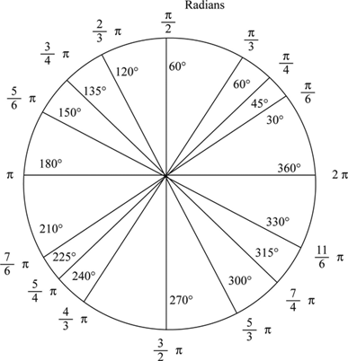

Slide 28
Memorizing the unit circle
1) Place your angle on the circle.
2) Decide the placement: small x/large y, medium x and y, or large x/small y
3) Choose the corresponding sin and cos values: 0, $\frac{1}{2}$ , $\frac{\sqrt{2}}{2}$ , $\frac{\sqrt{3}}{2}$ , 1
4) Decide if the values are positive or negative.

Slide 29
Find the sine and cos of each angle:
a) $\frac{π}{3}$ b) $\frac{3π}{4}$ c) $\frac{7π}{6}$

Slide 31
13.3 – Trigonometric Functions of Any Angle

Slide 33
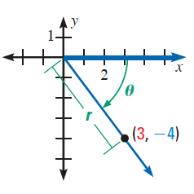

Slide 34
Quadrangles

Slide 35
Reference Angles

Slide 36
Finding reference angles

Slide 37
Sign of trigonometric functions

Slide 38
Evaluating Trigonometric Functions
1) Find the reference angles.
2) Evaluate the trigonometric function for the reference angle.
3) Decide the sign of the trigonometric function for the angle based on its quadrant.

Slide 40
13.4 – Inverse Trigonometry Functions

Slide 42
Evaluating Inverse Trigonometric Functions

Slide 43
Solving a Trigonometric Equation

Slide 45
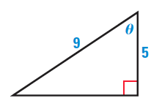
Finding Angle Measures

Slide 46
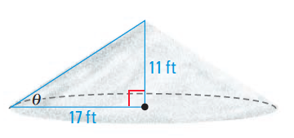

Slide 47
13.5 – The Law of Sines

Slide 48
Cases of non-right triangles to solve
1) Two angles and any side (AAS or ASA)
2) Two sides and an opposite angle (SSA)
3) Three sides (SSS)
4) Two sides and their included angles (SAS)

Slide 49
Labelling Triangles

Slide 50
The law of sines can be used when you have an angle and opposite side, and one more angle or side.

Slide 51
AAS or ASA Case - only one triangle determined

Slide 52
SSA possible cases

Slide 53
SSA – One Triangle Case

Slide 54
SSA – No Triangle Case

Slide 55
SSA – Two Triangles Case

Slide 56
Area of a triangle

Slide 57
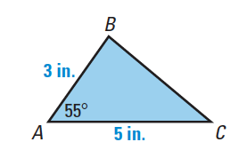

Slide 58
13.6 – The Law of Cosines

Slide 59
Cases of non-right triangles to solve
1) Two angles and any side (AAS or ASA)
2) Two sides and an opposite angle (SSA)
3) Three sides (SSS)
4) Two sides and their included angles (SAS)

Slide 60
The law of cosines should be used when the law of sines doesn’t work.

Slide 61
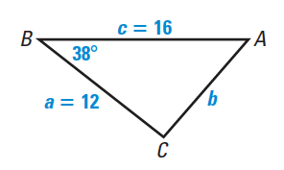
The SAS case

Slide 62
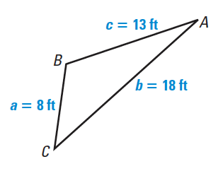
The SSS case

Slide 63
Area of a Triangle – Heron’s formula

Slide 64
