Slide 1
Chapter 8
Exponential and Logarithmic functions

Slide 2
8.1/8.2 - Exponential growth and decay

Slide 3
Basic exponential function
$$f\left(x\right)=b^{x}$$
It has a horizontal asymptote because it will never reach zero, no matter what x-value you put in the function.

Slide 4
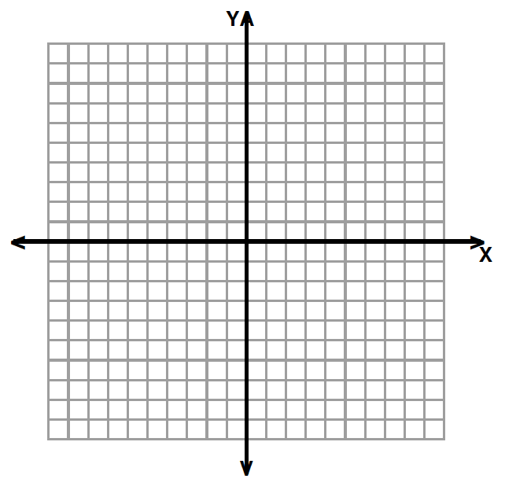
Growth vs. Decay
Graph $f\left(x\right)=2^{x}$
x | $$f\left(x\right)=2^{x}$$
-3
-2
-1
0
1
2
3

Slide 5
Growth vs. Decay
Graph $f\left(x\right)={\left(\frac{1}{2}\right)}^{x}$
x | $$f\left(x\right)=2^{x}$$
-3
-2
-1
0
1
2
3

Slide 6
Growth vs. Decay
Growth | Decay

Slide 7
Parameter “a” $f\left(x\right)=a∙b^{x}$

Slide 8
Steps for graphing$f\left(x\right)=a∙b^{\left(x−h\right)}+k$
Create a table of values for the basic functions, using -1,0, and 1 for x.
2) Apply the transformations using a, h, and k to get the actual points and create a new table of values.
x→ x+h
y→ ay+k
3) Draw the asymptote y=k
x | -1 | 0 | 1
y | 1/b | 1 | b

Slide 9
Parameters “h” and “k” $f\left(x\right)=a∙b^{\left(x−h\right)}+k$

Slide 10
Parameters “h” and “k” $f\left(x\right)=a∙b^{\left(x−h\right)}+k$

Slide 11
Exponentials to represent growth or decay.
When a real-life quantity increases by a fixed percent each year, the quantity can be modeled by:
$$y=a{(1+r)}^{t}$$
For decay: $y=a{(1−r)}^{t}$

Slide 12
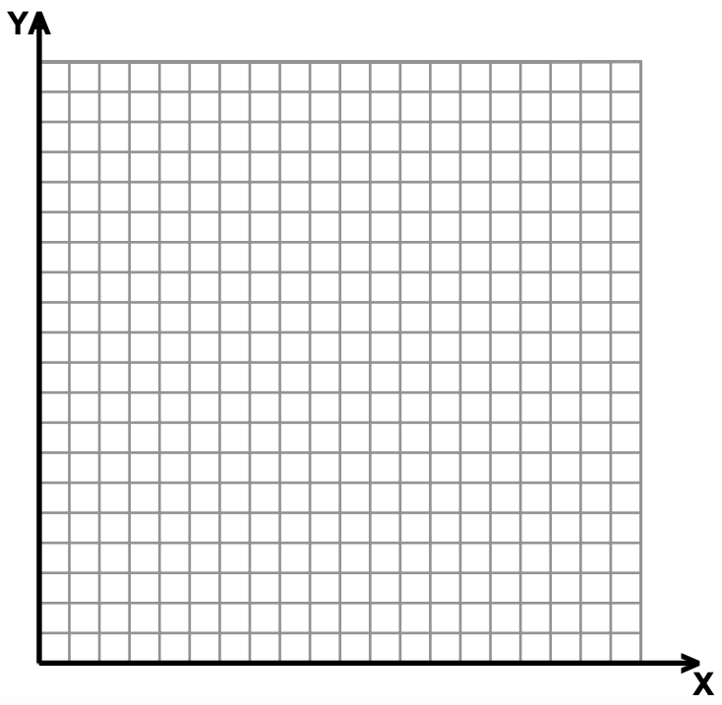

Slide 14
Compound interest

Slide 16
8.3 – The Number $e$

Slide 19
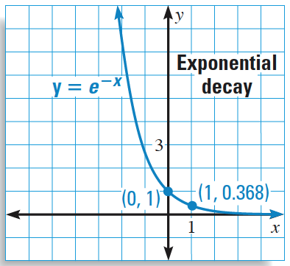
Graphing $f\left(x\right)=ae^{rx}$
Look at “r” to determine if the function is growth or decay.
Use the same table of values
$e=2.718$ and $\frac{1}{e}=0.368$
x | -1 | 0 | 1
y | 1/b | 1 | b

Slide 20
Graphing functions with $e$
Look at “a” and the exponent to see if it is a growth or decay function.
A and exponent are
fdsfg

Slide 22
Use of $e$ in real life
Recall from 8.1, we can calculate compound interest using the formula $A=P{\left(1+\frac{r}{n}\right)}^{nt}.$
When we compound interest continuously, the same formula yields $A=Pe^{rt}$.

Slide 25
8.4 – Logarithmic function

Slide 26
Solve the following equations:
$2^{x}=32$ $3^{x}=9$
$3^{x}=\frac{1}{27}$ $5^{x}=125$

Slide 27
Definition: Logarithms
Logarithms are the inverse of exponentials. They answer the question ”c to what power gives x?”
Logarithmic form | Exponential Form
$$\log_{c}a=x$$ | $$c^{x}=a$$
$$\log_{5}625=x$$
 | $${35}^{x}=8$$
$$\log_{7}49=x$$
 | $$5^{x}=100$$

Slide 28
Special log values

Slide 30
Common and natural logs

Slide 31
Exponential and log as inverse

Slide 32
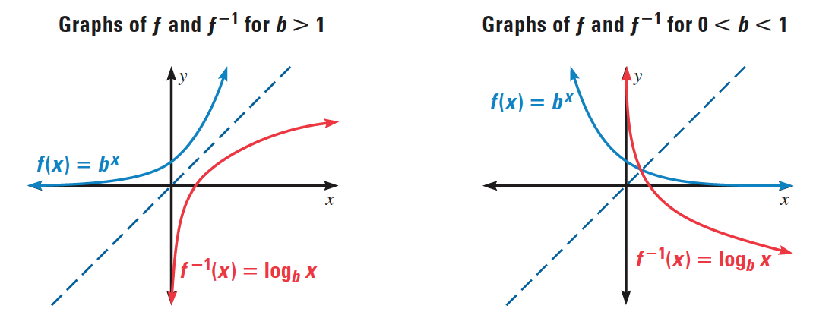
Exponential and log as inverse

Slide 33
Basic logarithmic function
$$f\left(x\right)=\log_{b}x$$
It has a vertical asymptote because zero

Slide 34
Effect of “b”
Graph$f\left(x\right)=\log_{2}x$
x | $$f\left(x\right)=2^{x}$$
1/2
1
2

Slide 35
Effect of “b”
Graph $f\left(x\right)=\log_{\frac{1}{2}}x$
x | $$f\left(x\right)=2^{x}$$
1/2
1
2

Slide 36
Steps for graphing $f\left(x\right)=a\log_{b}\left(x−h\right)+k$
Create a table of values for the basic functions, using -1,0, and 1 for x.
2) Apply the transformations using a, h, and k to get the actual points and create a new table of values.
x→ x+h
y→ ay+k
x | 1/b | 1 | b
y | -1 | 0 | 1

Slide 37
Parameters “h” and “k”

Slide 38
Parameters “h” and “k

Slide 39
8.5 – Properties of logarithms

Slide 40
Properties of logarithms

Slide 42
Expanding logs

Slide 43
Condensing logs

Slide 44
Change of base
This property is useful to plug in logarithms in your calculator, which only has the natural and common logarithms.

Slide 45
Change of base proof (not on test)

Slide 46
Using the change of base formula

Slide 47
8.6 – Solving exponential and logarithmic equations

Slide 48
Types of equations
Exponential | Logarithmic
Same base, or can get to the same base. Different base. | → Both sides have log with same base. → Only one side has a log.

Slide 49
Equivalent values
For each mathematical sentence, determine the value of $x$.
Sentence | Value of $x$
$$2×x=2×5$$ | $$x=______$$
$$x÷4=8÷4$$ | $$x=______$$
$$x+10=6+10$$ | $$x=______$$

Slide 50
Equal powers property
For $b>0$ and $b≠1$,
if $b^{x}=b^{y}$, then $x=y$
Ex: If $3^{x}=3^{5}$ then $x=5$

Slide 51
Equal powers property
For each mathematical sentence, determine the value of $x$.
Sentence | Value of $x$
$$5^{2}=5^{x}$$ | $$x=______$$
$$2^{5}=2^{x}$$ | $$x=______$$
$$7^{3}=7^{x}$$ | $$x=______$$

Slide 52
Exponential equations: Same base
Examples:
$$3^{2x+4}=3^{10}$$ | $$4^{3x−6}=2^{18}$$

Slide 53
Recap: Solving exponential equations
1. Rewrite both sides of the equation with a common base.
2. Set the exponents on each side equal to each other.
3. Solve the equation.
4. Check your answer.

Slide 54
Equal logarithms property
For positive numbers $b$, $x$ and $y$ where $b≠1$,
$\log_{b}{x}=\log_{b}{y} if and only if$ $x=y$
Ex: $\log_{3}{x}=\log_{3}{5}$ if and only if $x=5$

Slide 55
Equal Logarithms property
For each mathematical sentence, determine the value of $x$.
Sentence | Value of $x$
$$\log_{5}\left(2\right)=\log_{5}\left(x\right)$$ | $$x=______$$
$$\log_{2}\left(5\right)=\log_{2}\left(x\right)$$ | $$x=______$$
$$\log_{7}\left(3\right)=\log_{7}\left(x\right)$$ | $$x=______$$

Slide 56
Log equations: same base
Examples:
$$\log_{3}{(2x+4)}=\log_{3}{(3x+3)}$$ | $$\log_{5}{(3x−4)}−\log_{5}{(x)}=\log_{5}{(2)}$$

Slide 57
Recap: Solving Logarithmic equations
1. Rewrite both sides of the equation as one log with common base.
2. Set the insides of the log on each side equal to each other.
3. Solve the equation.
4. Check your answer - remove extraneous solutions.

Slide 58
Take the common log of each side
When you are unable to write both sides of the equation with a common base, you can take the common logarithm of each side.
Use the power rule to bring the exponent down.
$$\log_{b}{{(x}^{m})}=m\log_{b}{(x)}$$

Slide 59
Exponential equations: different base
Examples:
$$2^{x}=20$$ | $$5^{2x−3}=16$$

Slide 60
Recap: Solving exponential equations with different bases.
1. Take the common log of both sides.
2. Use the power rule to bring the exponent down.
3. Solve the equation.
4. Check your answer.

Slide 61
Exponentiate each side
When only one side is a logarithmic expression, exponentiate both sides.
Use the fact that log and exponents are inverses to cancel the log out.
$$b^{\log_{b}{x}}=x$$

Slide 62
Log equations: log on one side only.
Examples:
$$\log_{2}{(4x+3)}=3$$ | $${2log}_{3}{(2x+1)}=4$$

Slide 63
Recap: Solving Logarithmic equations
1. Exponentiate both sides.
2. Solve the equation.
3. Check your answer - remove extraneous solutions.

