Slide 1
Chapter 8
Exponential and Logarithmic functions

Slide 2
8.1/8.2 - Exponential growth and decay

Slide 3
Basic exponential function
$$f\left(x\right)=b^{x}$$
It has a horizontal asymptote because it will never reach zero, no matter what x-value you put in the function.

Slide 4
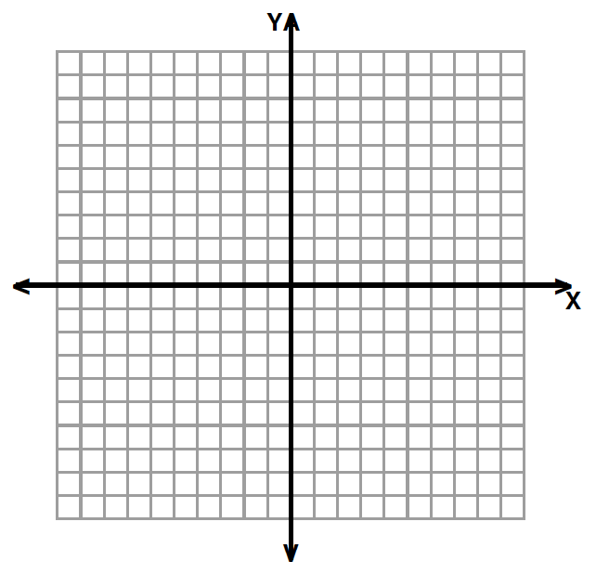
Growth vs. Decay
Graph $f\left(x\right)=2^{x}$
x | $$f\left(x\right)=2^{x}$$
-3
-2
-1
0
1
2
3

Slide 5
Growth vs. Decay
Graph $f\left(x\right)={\left(\frac{1}{2}\right)}^{x}$
x | $$f\left(x\right)=2^{x}$$
-3
-2
-1
0
1
2
3

Slide 6
Growth vs. Decay
Growth | Decay

Slide 7
Parameter “a” $f\left(x\right)=a∙b^{x}$

Slide 8
Steps for graphing$f\left(x\right)=a∙b^{\left(x−h\right)}+k$
Create a table of values for the basic functions, using -1,0, and 1 for x.
2) Apply the transformations using a, h, and k to get the actual points and create a new table of values.
x→ x+h
y→ ay+k
3) Draw the asymptote y=k
x | -1 | 0 | 1
y | 1/b | 1 | b

Slide 9
Parameters “h” and “k” $f\left(x\right)=a∙b^{\left(x−h\right)}+k$

Slide 10
Parameters “h” and “k” $f\left(x\right)=a∙b^{\left(x−h\right)}+k$

Slide 11
Exponentials to represent growth or decay.
When a real-life quantity increases by a fixed percent each year, the quantity can be modeled by:
$$y=a{(1+r)}^{t}$$
For decay: $y=a{(1−r)}^{t}$

Slide 12
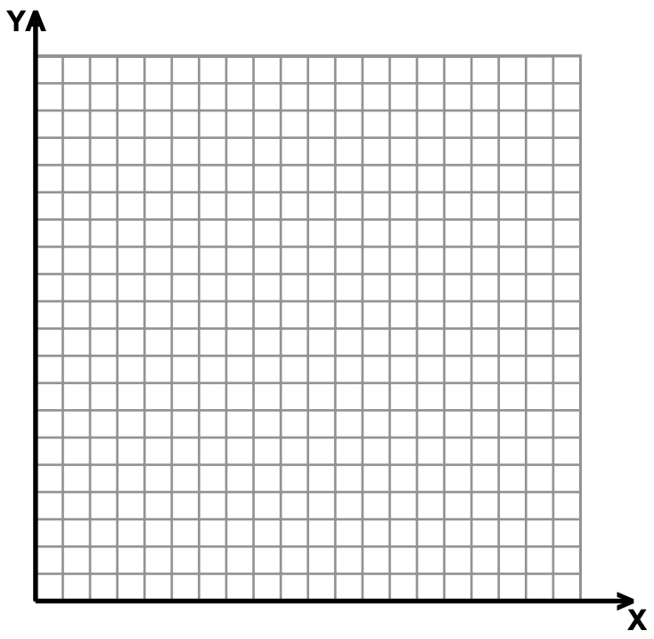

Slide 14
Compound interest

Slide 16
8.3 – The Number $e$

Slide 19
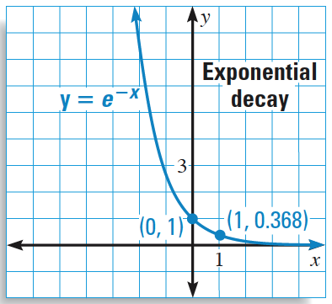
Graphing $f\left(x\right)=ae^{rx}$
Look at “r” to determine if the function is growth or decay.
Use the same table of values
$e=2.718$ and $\frac{1}{e}=0.368$
x | -1 | 0 | 1
y | 1/b | 1 | b

Slide 21
Use of $e$ in real life
Recall from 8.1, we can calculate compound interest using the formula $A=P{\left(1+\frac{r}{n}\right)}^{nt}.$
When we compound interest continuously, the same formula yields $A=Pe^{rt}$.

Slide 24
8.4 – Logarithmic function

Slide 25
Solve the following equations:
$2^{x}=32$ $3^{x}=9$
$3^{x}=\frac{1}{27}$ $5^{x}=125$

Slide 26
Definition: Logarithms
Logarithms are the inverse of exponentials. They answer the question ”c to what power gives x?”
Logarithmic form | Exponential Form
$$\log_{c}a=x$$ | $$c^{x}=a$$
$$\log_{5}625=x$$
 | $${35}^{x}=8$$
$$\log_{7}49=x$$
 | $$5^{x}=100$$

Slide 27
Special log values

Slide 29
Common and natural logs

Slide 30
Exponential and log as inverse

Slide 31
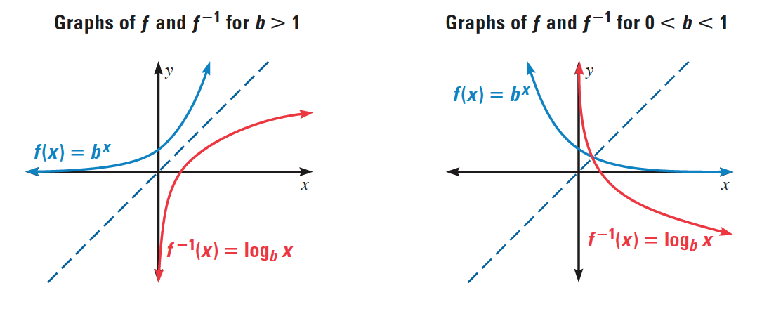
Exponential and log as inverse

Slide 32
Basic logarithmic function
$$f\left(x\right)=\log_{b}x$$
It has a vertical asymptote because zero

Slide 33
Effect of “b”
Graph$f\left(x\right)=\log_{2}x$
x | $$f\left(x\right)=2^{x}$$
1/2
1
2

Slide 34
Effect of “b”
Graph $f\left(x\right)=\log_{\frac{1}{2}}x$
x | $$f\left(x\right)=2^{x}$$
1/2
1
2

Slide 35
Steps for graphing $f\left(x\right)=a\log_{b}\left(x−h\right)+k$
Create a table of values for the basic functions, using -1,0, and 1 for x.
2) Apply the transformations using a, h, and k to get the actual points and create a new table of values.
x→ x+h
y→ ay+k
x | 1/b | 1 | b
y | -1 | 0 | 1

Slide 36
Parameters “h” and “k”

Slide 37
Parameters “h” and “k

Slide 38
8.5 – Properties of logarithms

Slide 39
Properties of logarithms

Slide 41
Expanding logs

Slide 42
Condensing logs

Slide 43
Change of base
This property is useful to plug in logarithms in your calculator, which only has the natural and common logarithms.

Slide 44
Change of base proof (not on test)

Slide 45
Using the change of base formula

Slide 46
8.6 – Solving exponential and logarithmic equations

Slide 47
Types of equations
Exponential | Logarithmic
Same base, or can get to the same base. Different base. | → Both sides have log with same base. → Only one side has a log.

Slide 48
Equal powers property
For $b>0$ and $b≠1$,
if $b^{x}=b^{y}$, then $x=y$
Ex: If $3^{x}=3^{5}$ then $x=5$

Slide 49
Exponential equations: Same base
Examples:
$$3^{2x+4}=3^{10}$$ | $$4^{3x−6}=2^{18}$$

Slide 50
Recap: Solving exponential equations
1. Rewrite both sides of the equation with a common base.
2. Set the exponents on each side equal to each other.
3. Solve the equation.
4. Check your answer.

Slide 51
Equal logarithms property
For positive numbers $b$, $x$ and $y$ where $b≠1$,
$\log_{b}{x}=\log_{b}{y} if and only if$ $x=y$
Ex: $\log_{3}{x}=\log_{3}{5}$ if and only if $x=5$

Slide 52
Log equations: same base
Examples:
$$\log_{3}{(2x+4)}=\log_{3}{(3x+3)}$$ | $$\log_{5}{(3x−4)}−\log_{5}{(x)}=\log_{5}{(2)}$$

Slide 53
Recap: Solving Logarithmic equations
1. Rewrite both sides of the equation as one log with common base.
2. Set the insides of the log on each side equal to each other.
3. Solve the equation.
4. Check your answer - remove extraneous solutions.

Slide 54
Exponential equations: different base
Examples:
$$2^{x}=20$$ | $$5^{2x−3}=16$$

Slide 55
Recap: Solving exponential equations with different bases.
1. Take the common log of both sides.
2. Use the power rule to bring the exponent down.
3. Solve the equation.
4. Check your answer.

Slide 56
Log equations: log on one side only.
Examples:
$$\log_{2}{(4x+3)}=3$$ | $${2log}_{3}{(2x+1)}=4$$

Slide 57
Extraneous Solutions

Slide 58
Recap: Solving Logarithmic equations
1. Exponentiate both sides.
2. Solve the equation.
3. Check your answer - remove extraneous solutions.

