Slide 1
Chapter 13 – Right Triangles and Trigonometry

Slide 2
13.1 – Simplifying Square Roots

Slide 3
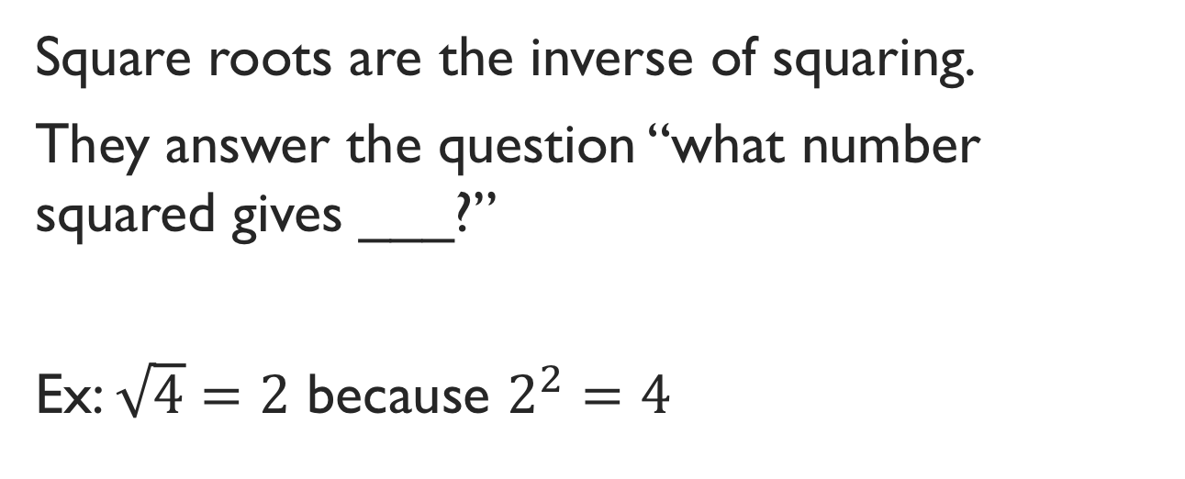
Definition: square roots
Square roots are the inverse of squaring.
They answer the question “what number squared gives ___?”
Ex: $\sqrt{4}=2$ because $2^{2}=4$

Slide 4
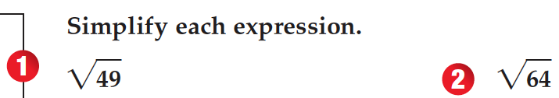

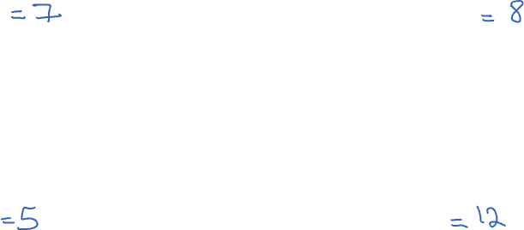

Slide 5
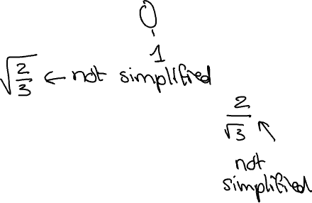
Simplifying square roots
1. There are no perfect square factors other than 1 in the radicand.
2. The radicand is not a fraction.
3. The denominator does not contain a radical expression.

Slide 6
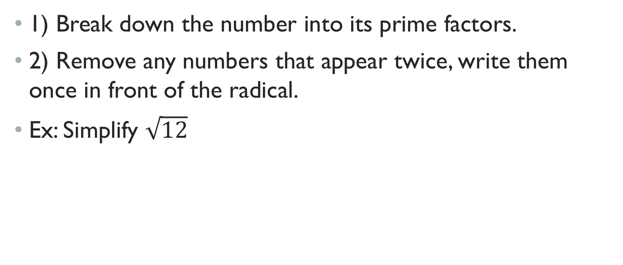
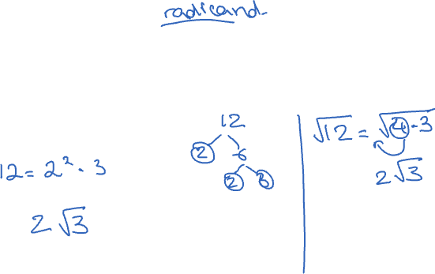
Pulling out perfect squares
1) Break down the number into its prime factors.
2) Remove any numbers that appear twice, write them once in front of the radical.
Ex: Simplify $\sqrt{12}$

Slide 7
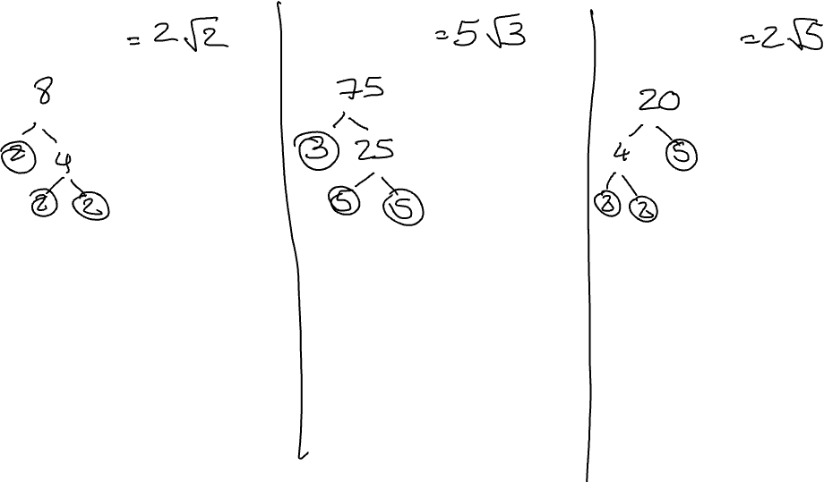

Slide 8
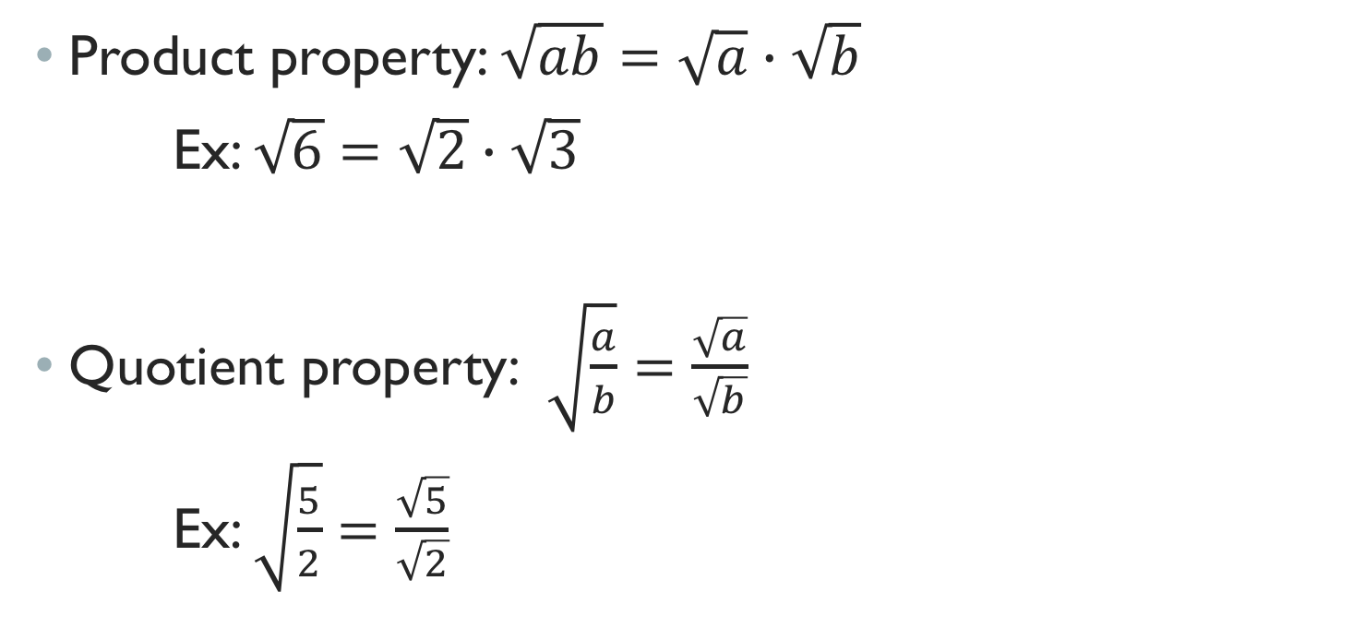
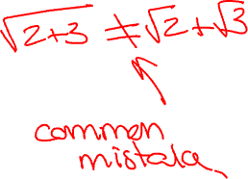
Properties of square roots
Product property: $\sqrt{ab}=\sqrt{a}∙\sqrt{b}$
Ex: $\sqrt{6}=\sqrt{2}∙\sqrt{3}$
Quotient property: $\sqrt{\frac{a}{b}}=\frac{\sqrt{a}}{\sqrt{b}}$
Ex: $\sqrt{\frac{5}{2}}=\frac{\sqrt{5}}{\sqrt{2}}$

Slide 9

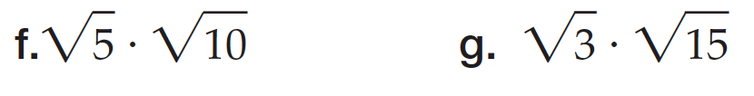
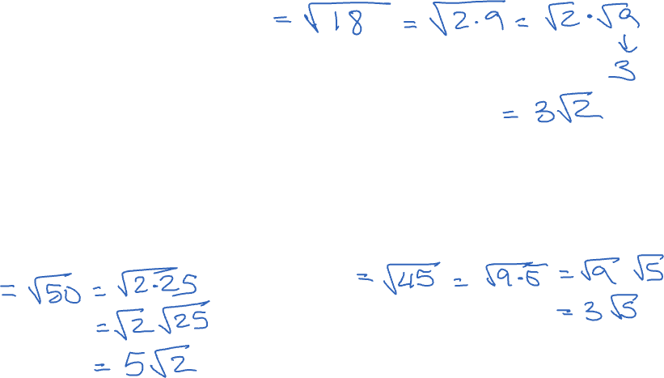

Slide 10
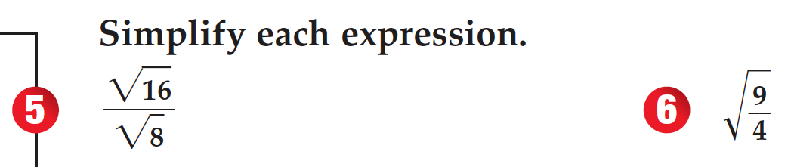
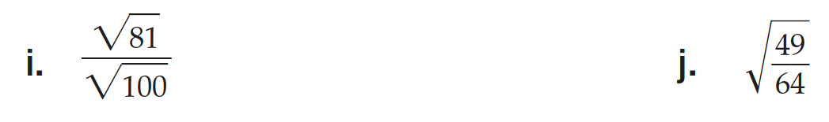
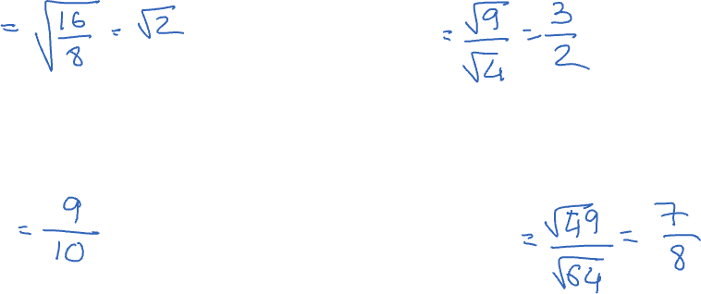

Slide 11
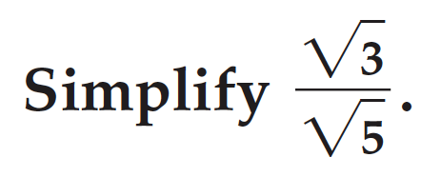
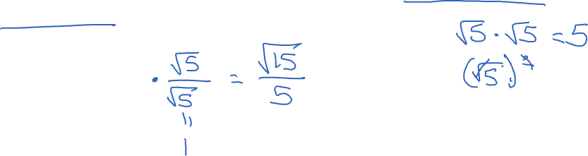
Radicals in the denominator
When radicals are present in the denominator, rationalizing the denominator is necessary.
Ex:

Slide 12

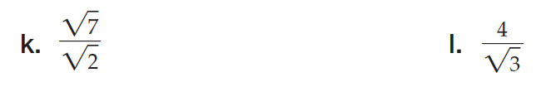
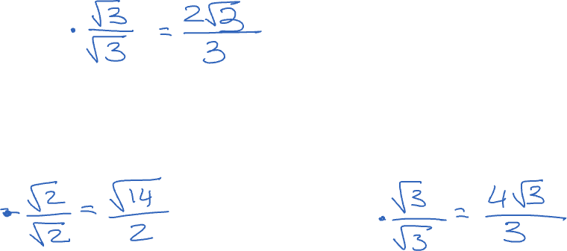

Slide 13
13.2 – 45-45-90 Triangles

Slide 14
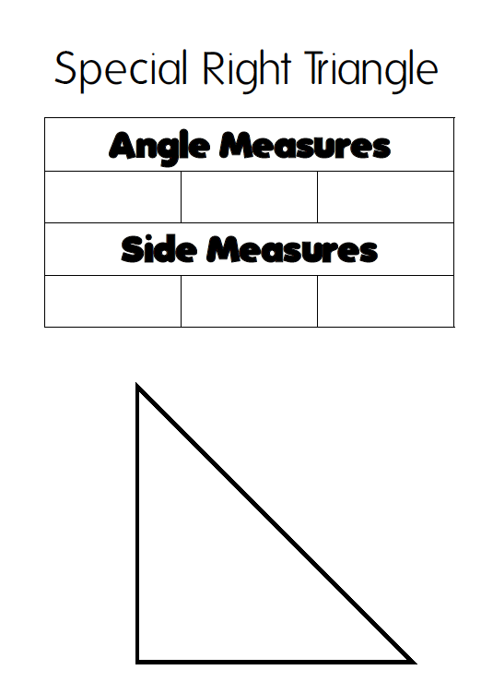
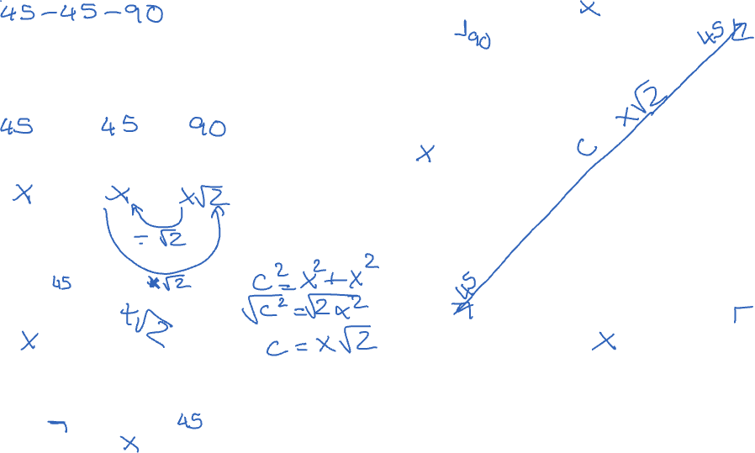


Slide 15
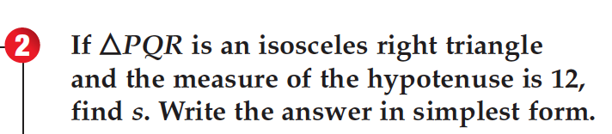
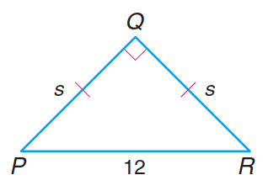
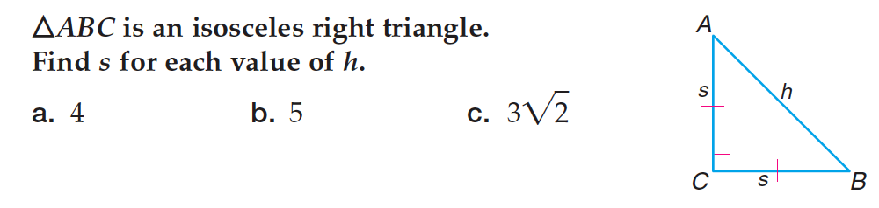
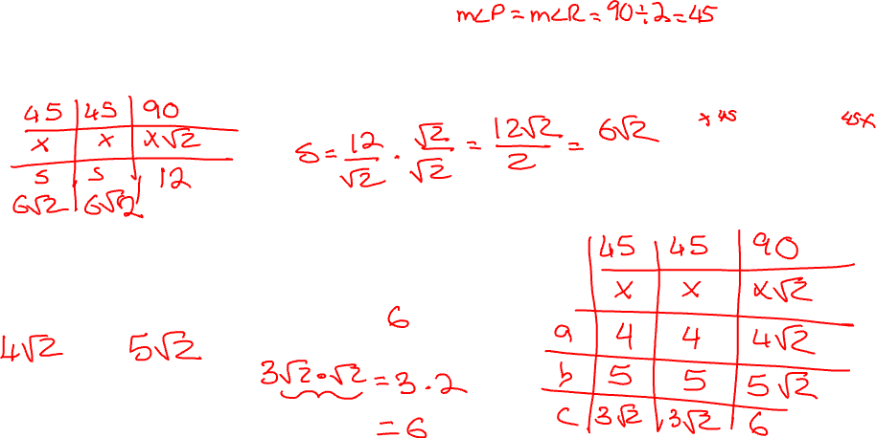

Slide 16
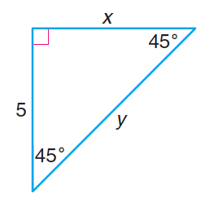
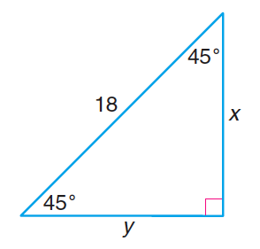
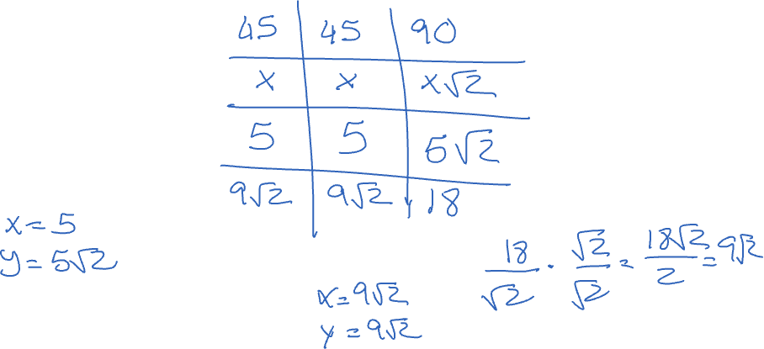

Slide 17
13.3 – 30-60-90 Triangles

Slide 18
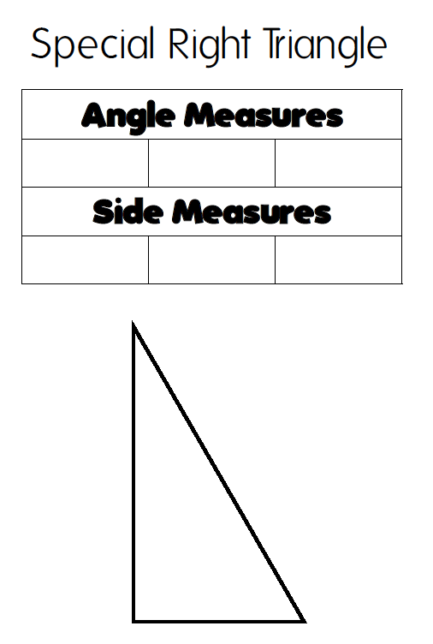
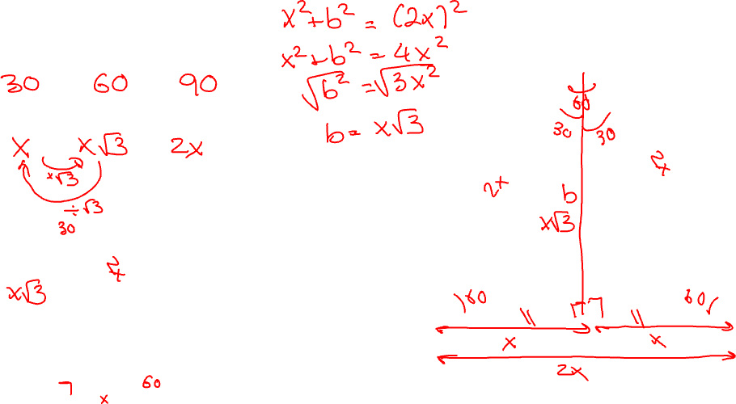


Slide 19
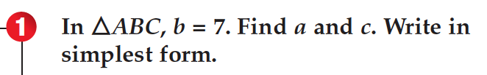
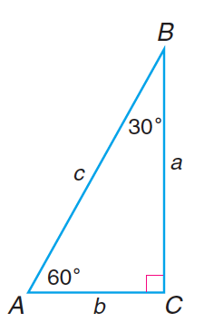
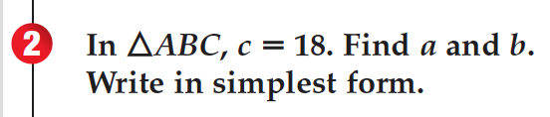
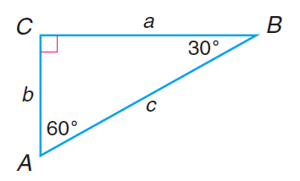
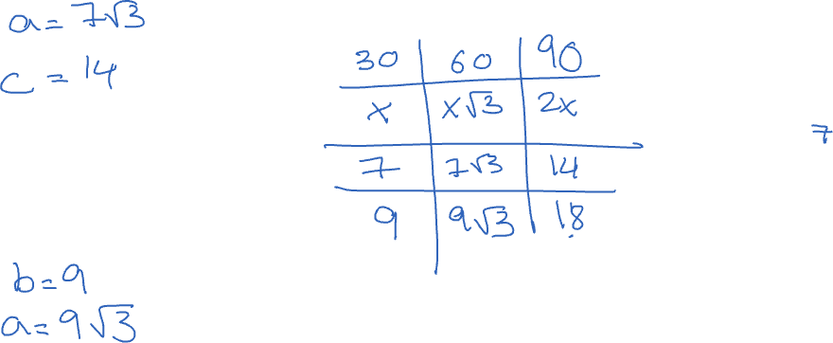

Slide 20
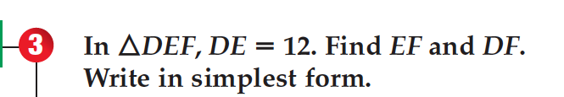
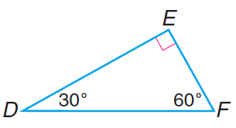
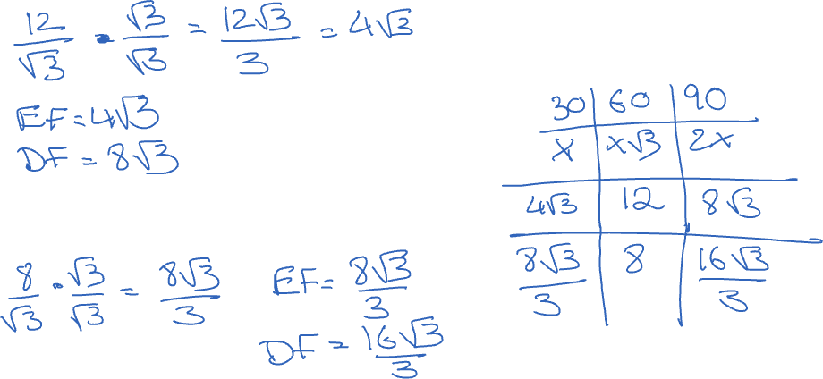

Slide 21
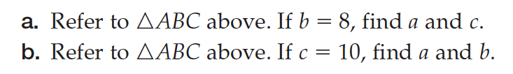

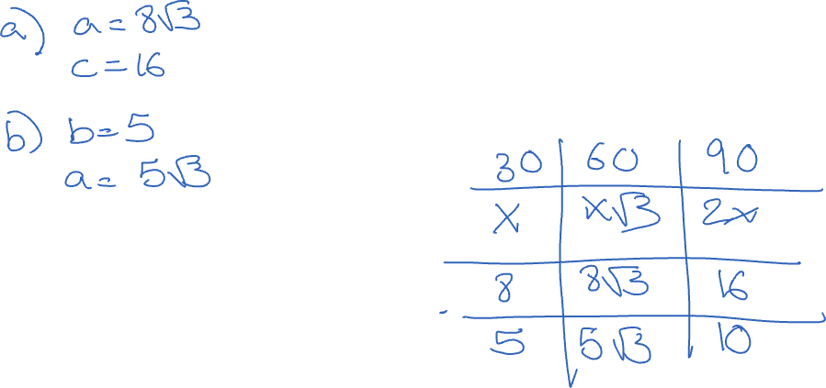

Slide 22
13.4/5 Trigonometric Ratios

Slide 23
Definitions
Trigonometry comes from Greek: trigon means triangles and metron means measure. Trigonometry involves the measure of triangles.
A trigonometric ratio is a ratio of the lengths of two sides of a triangle. Trig ratios are constant for any given angle measure (due to similarity properties).

Slide 24
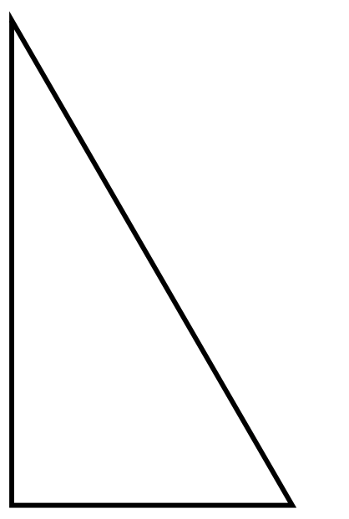
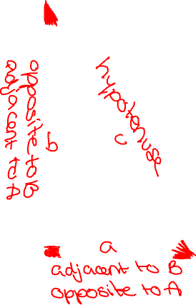
Labelling Triangles
A
C
B

Slide 25
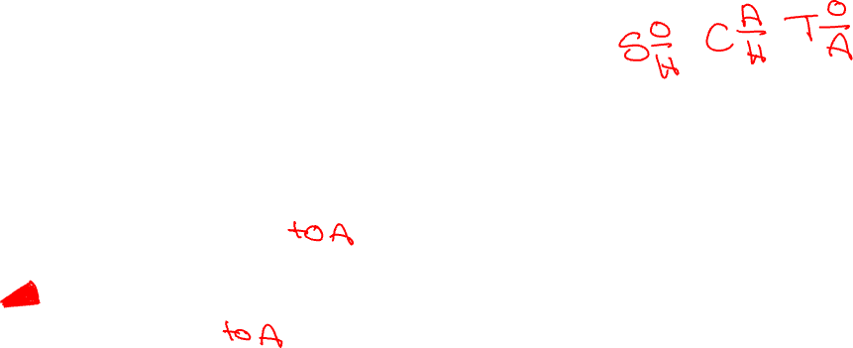
Trigonometric ratios

Slide 26

Finding a ratio
1) Identify the angle you are working with.
2) Identify the angles opposite and adjacent sides.
3) Write the ratio.

Slide 27
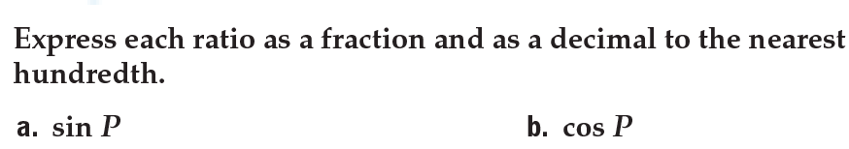
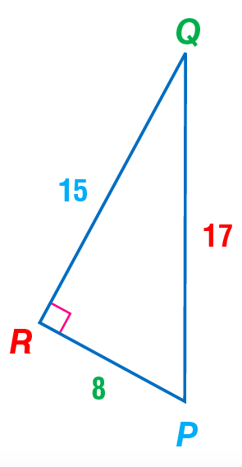
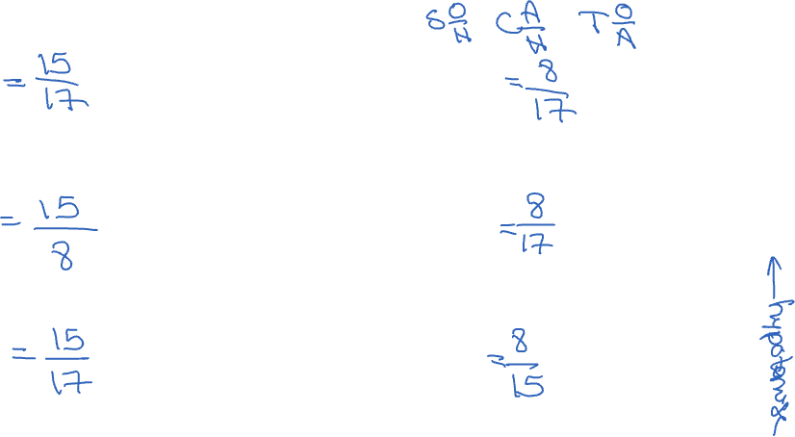

Slide 28
Finding Missing measures
1) Identify the angle you have or are looking for.
2) Identify one side you have, and one you have or are looking for.
3) Determine the trigonometric ratio that relates all 3 items.
4) Write the ratio and solve it.
Note: when looking for an angle, you must use the inverse to find the angle.
Solving a right triangle means finding all angle and side measures.

Slide 29
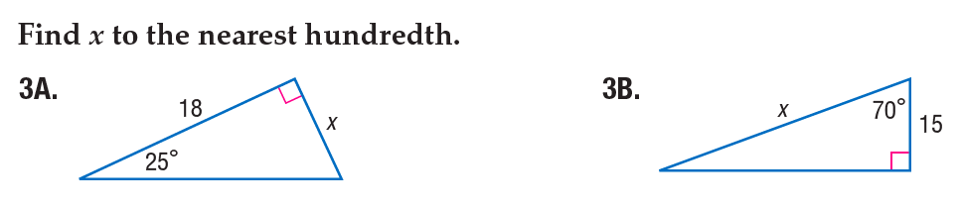
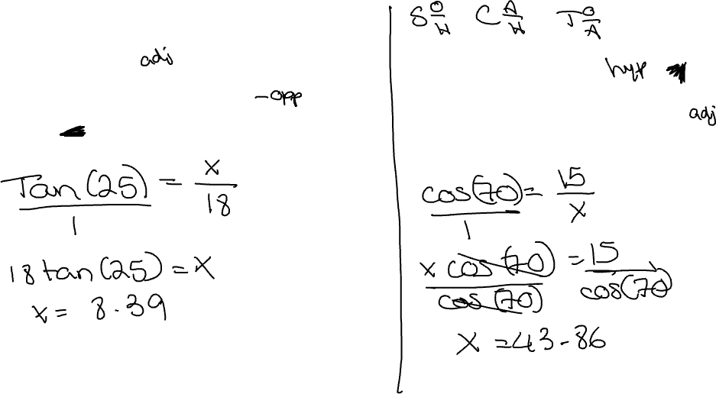

Slide 30
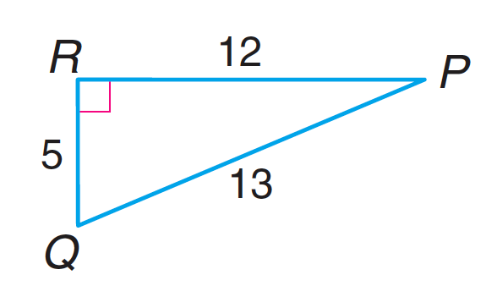
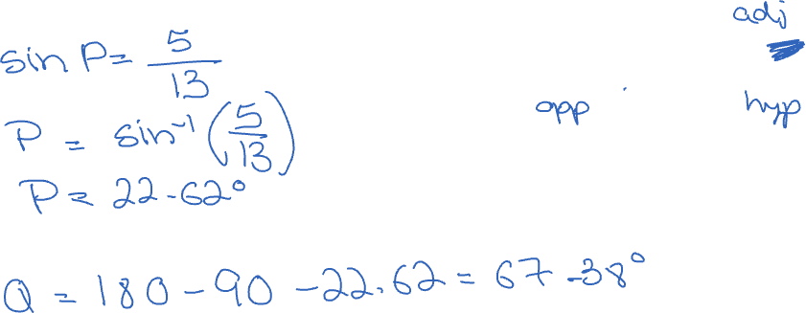
Find the measures of each angle.

Slide 31
