Slide 1
CHAPTER 12 SURFACE AREA AND VOLUME

Slide 2
12.1 – SOLID FIGURES

Slide 3
Solids
All figures above are examples of solid figures or solids.
Solids with flat surface that are polygons are called polyhedrons or polyhedra.

Slide 4
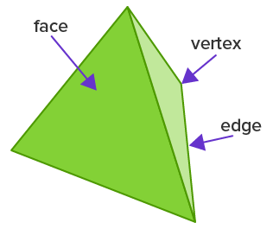
Parts of a polyhedron

Slide 5
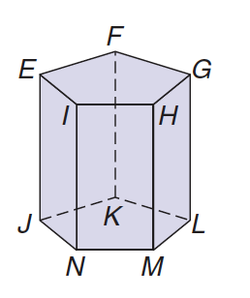

Slide 6
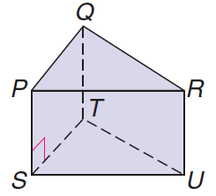

Slide 7
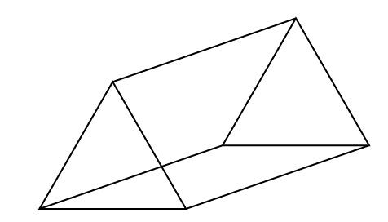
Prisms and Pyramids
Prism
Lateral faces are rectangular.
Two bases.
Pyramid
Lateral faces are triangular.
One base.

Slide 8
Classification
Prisms and pyramids are classified according to the shape of their base.

Slide 9
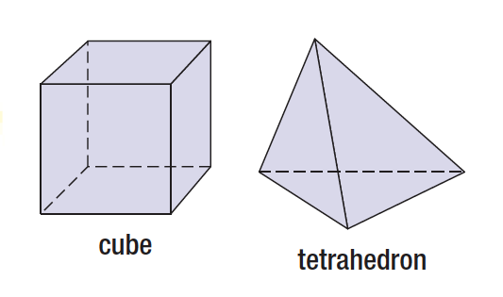
Special solids
Prisms and pyramids are classified according to the shape of their base.

Slide 10
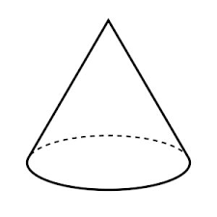
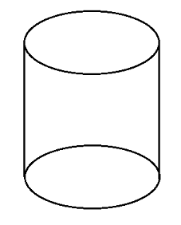
Cylinders and cones
Cylinders and cones are not polyhedral because they have curved lateral faces.
Cylinder
Two bases.
Cone
One base.

Slide 11
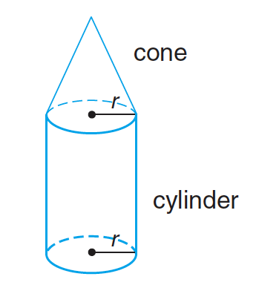
Composite solids
Composite solids are formed when several solids are combined to for a new solid.

Slide 12
12.2 – SURFACE AREA OF PRISMS AND CYLINDERS

Slide 13
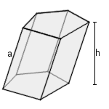
Oblique prisms and cylinders.
Solids are oblique when they are slanted. In this case, the height of the prisms and cylinder does not correspond to the edges.
Oblique prism: Oblique cylinder:

Slide 14
Area definitions
Lateral area includes the area of all the lateral faces.
Surface area includes the area of lateral faces and bases.
For prisms and cylinders:
$$SA=LA+2∙A_{base}$$
For pyramids and cones:
$$SA=LA+A_{base}$$

Slide 15
Area using nets

Slide 16
Prisms and cylinders as layering of shapes
It can be more convenient to think of prisms and cylinders as a stack of shapes.
Using this method, we can use the formula:
$$LA=P_{base}∙h$$
$$SA=P_{base}∙h+2A_{base}$$

Slide 17
Area using stacking

Slide 18
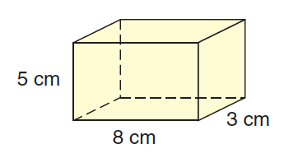
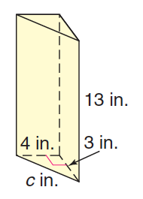

Slide 19
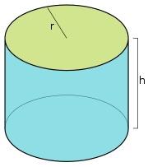
Prisms and cylinders as layering of shapes
$$LA=P_{base}∙h$$
$$SA=P_{base}∙h+2A_{base}$$
For cylinders, we can replace the perimeter and area by their formulas, which give us:
$$LA=2πr∙h$$
$$SA=2πrh+2πr^{2}$$

Slide 20
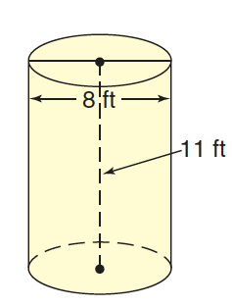
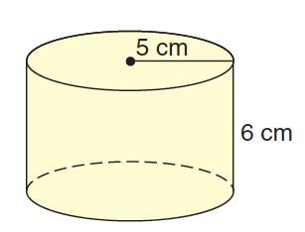

Slide 21
12.3 – VOLUME OF PRISMS AND CYLINDERS

Slide 22
Definition: Volume
Volume is the amount of space contained in a solid. It is measured in cubic units.

Slide 23
Prisms and cylinders as layering of shapes
Formula:
$$V=A_{base}∙h$$
For cylinders, you can replace the area by the formula for the area of a circle.
$$V=πr^{2}∙h$$

Slide 24
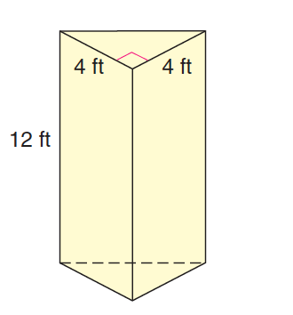

Slide 25
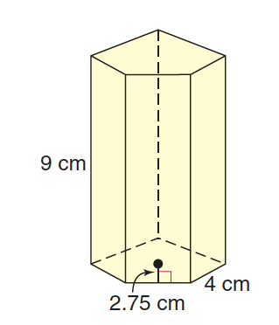

Slide 26
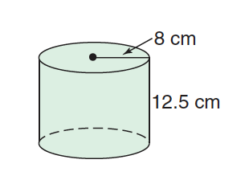

Slide 28
12.4 – SURFACE AREA OF PYRAMIDS AND CONES

Slide 29
Area using nets

Slide 30
Area using perimeter
$$LA={\frac{1}{2}P}_{base}∙l$$
$$SA={\frac{1}{2}P}_{base}l+A_{base}$$
For a cone, you can replace perimeter and area of circle by their formula.
$$LA=πrl$$
$$SA=πrl+πr^{2}$$

Slide 31
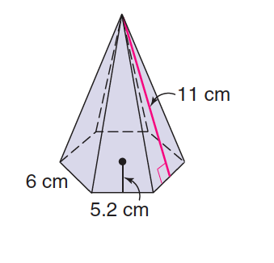

Slide 33
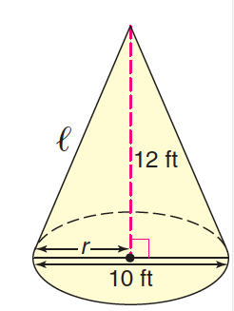

Slide 35
12.5 – VOLUME OF PYRAMIDS AND CONES

Slide 36
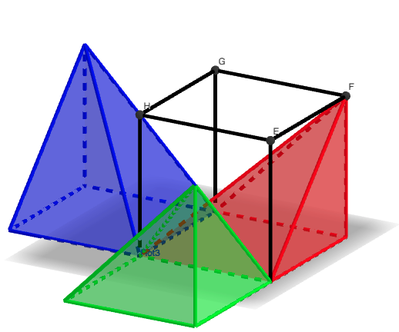
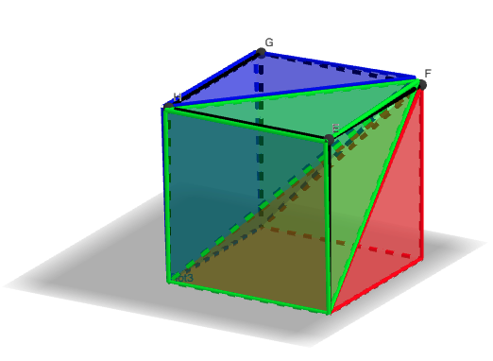
Volume of a pyramid demo
https://www.geogebra.org/m/jwf5y73q

Slide 37
Volume of pyramids and cones
$$V=\frac{1}{3}A_{base}∙h$$
For a cone, replace with formula for area of a circle:
$$V=\frac{1}{3}πr^{2}h$$

Slide 38
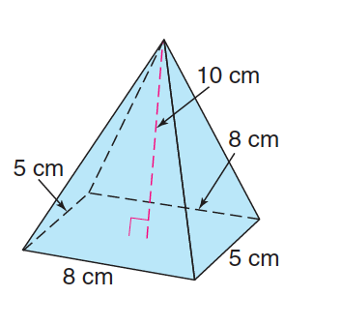

Slide 40
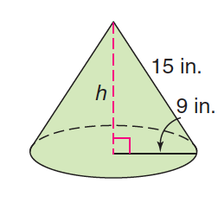

Slide 42
12.6 – SPHERES

Slide 43
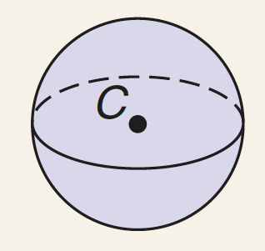
Area and Volume Formulas
Spheres have no base, so there is only one area (no distinction between lateral and surface areas.)
Surface Area: $S=4πr^{2}$
Volume: V$=\frac{4}{3}πr^{3}$

Slide 44
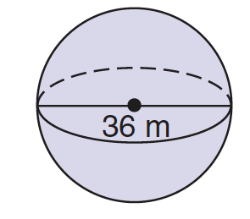

Slide 46
Area and volume of composite solids
To find the area or volume of composite solids, calculate the area or volume of the individual solids they are made up of and add them together.

Slide 47
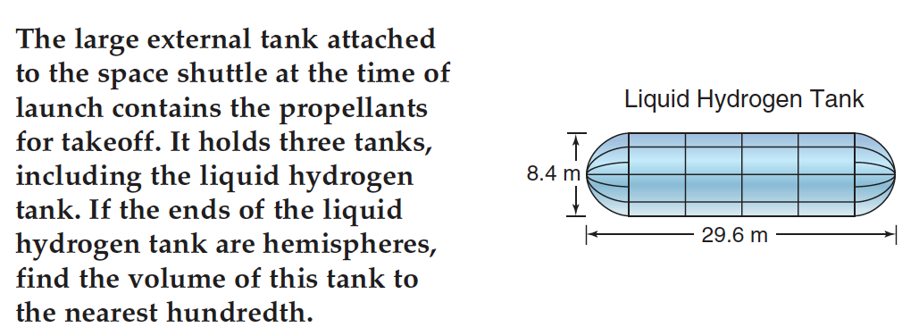

Slide 48
12.7 – SIMILARITY OF SOLID FIGURES

Slide 49
Similar solids
Just like similar figures, similar solids have the same shape, but not the same size. All their measures are proportional.

Slide 51
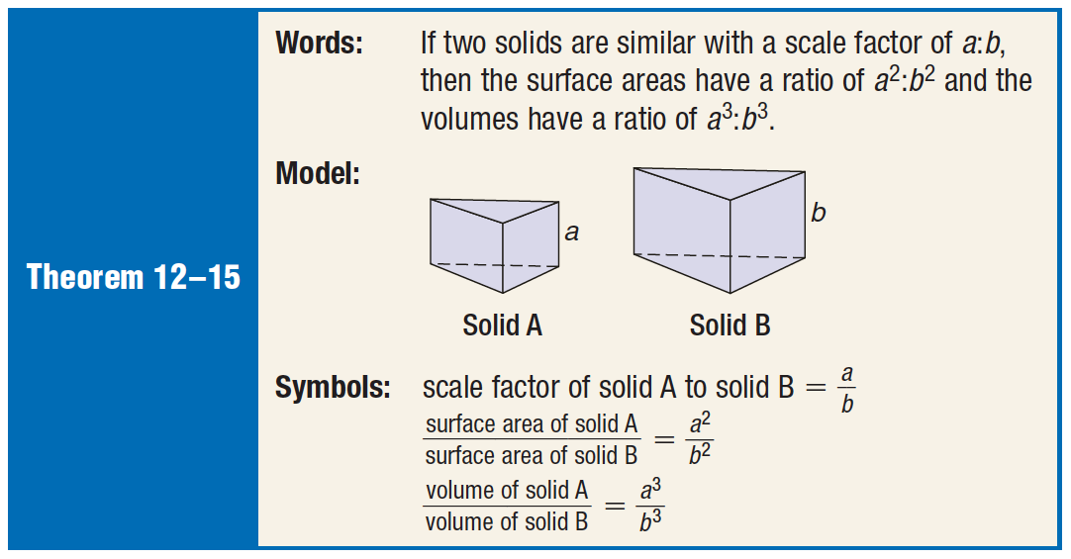
Scale factor relationships
In similar solids, the areas and volumes are also proportional, but their scale factors are squares for area and cubed for volume.

Slide 52
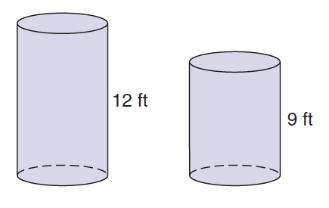

Slide 53
